Slide 1


Local Regulation of Interchange Turbulence in a Dipole-Confined Plasma Torus using Current-Collection Feedback
T. Maximillian Roberts
CTX/LDX Group
Department of Applied Physics and Applied Math – Columbia University
Plasma Science and Fusion Center – MIT
2014 APS-DPP New Orleans, LA
October 29, 2014

Slide 2
Outline
Introduction
  Magnetospheric Configurations in Space and the Lab
  CTX Device and Interchange Turbulence
Current-Collection Feedback in CTX
Four Types of Experiments
  Coherent Current-Collection (feed-forward)
  Triggered Feedback
  Gain and Phase Scans
  Varying Sensor and Electrode Positions
Linear Flux-Tube Averaged Gyro-Fluid Model
Ongoing Work and Conclusion

Slide 3
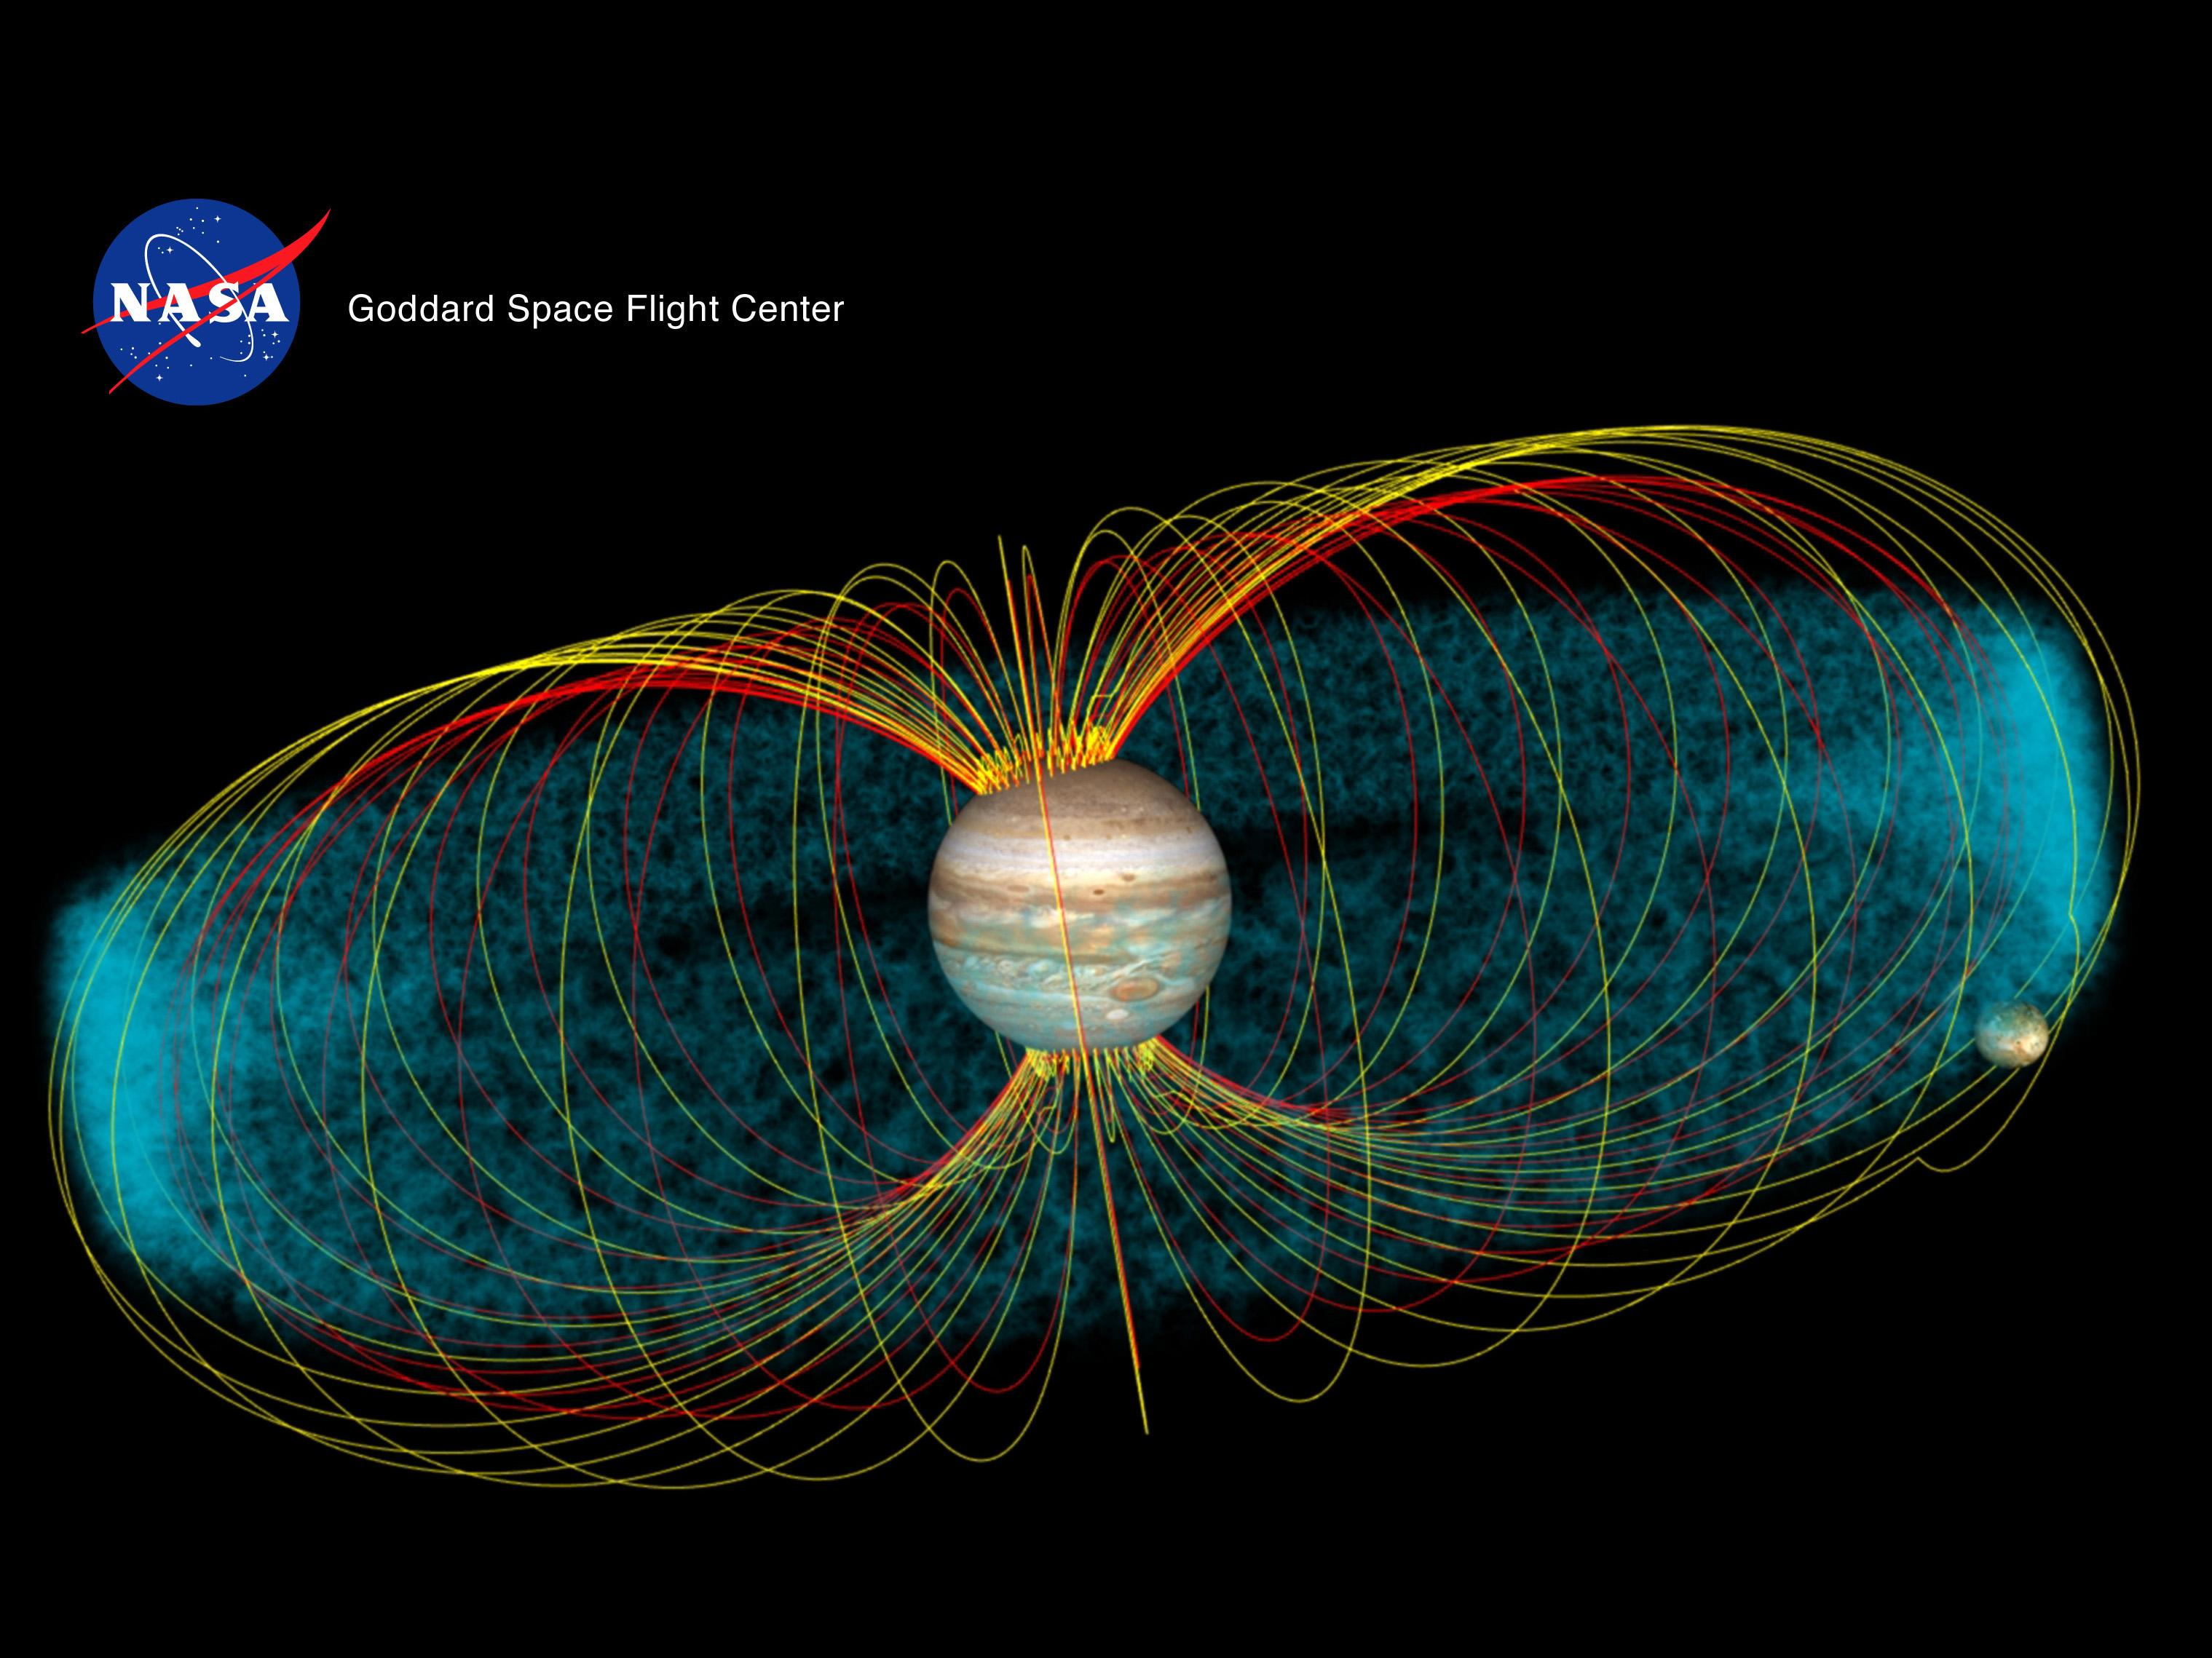
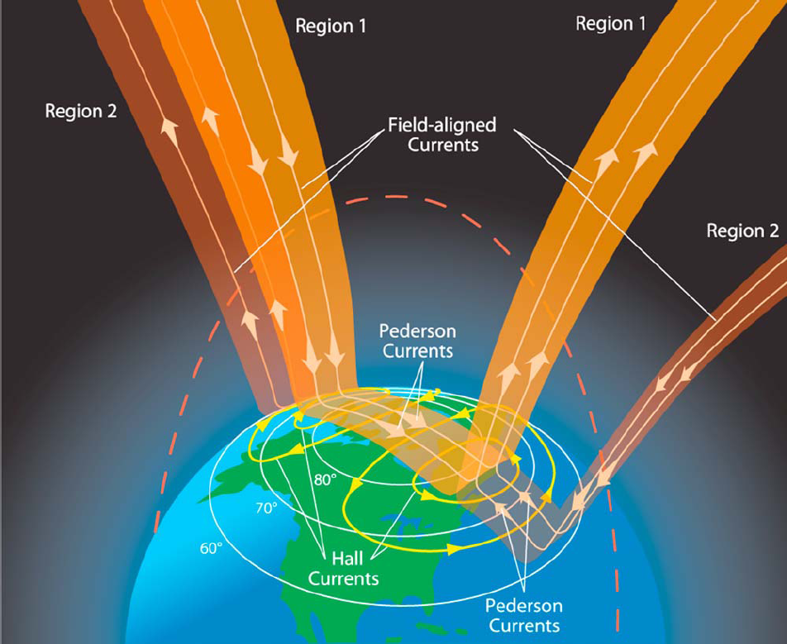
Planetary Magnetospheres have Field-Aligned Currents
Planetary magnetospheres have dipolar magnetic geometries.
Solar wind drives steady magnetospheric convection.
Cross-field conductivity is much higher in the ionosphere.
Field aligned currents couple these systems.
Magnetospheric generator is regulated by ionospheric load.
Le, G.; J. A. Slavin; R. J. Strangeway (2010) J. Geophys. Res. 115 (A07202).

Slide 4
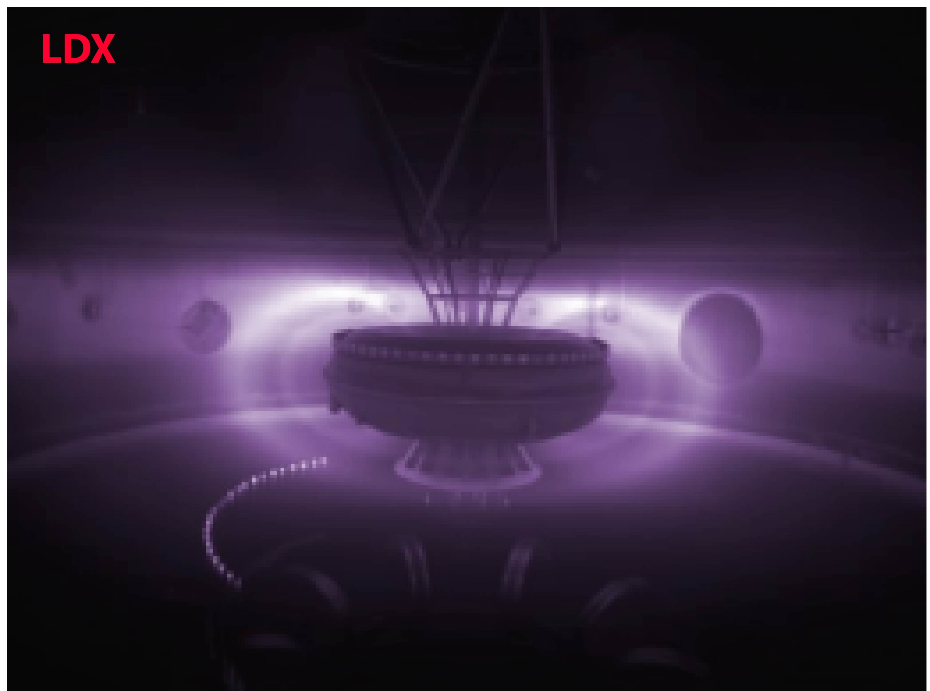
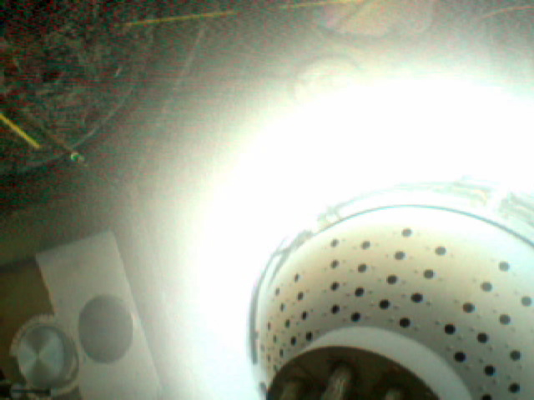
Laboratory Magnetospheres with No Field-Aligned Currents
LDX Levitated
LDX has a levitated superconducting coil with closed field lines, no parallel currents
CTX has insulating polar caps which prevent field aligned currents.
New Result: Controlled addition of current to individual flux-tubes allows us to explore the response of global interchange motion.
Like a “controlled ionosphere”
CTX Insulated

Slide 5
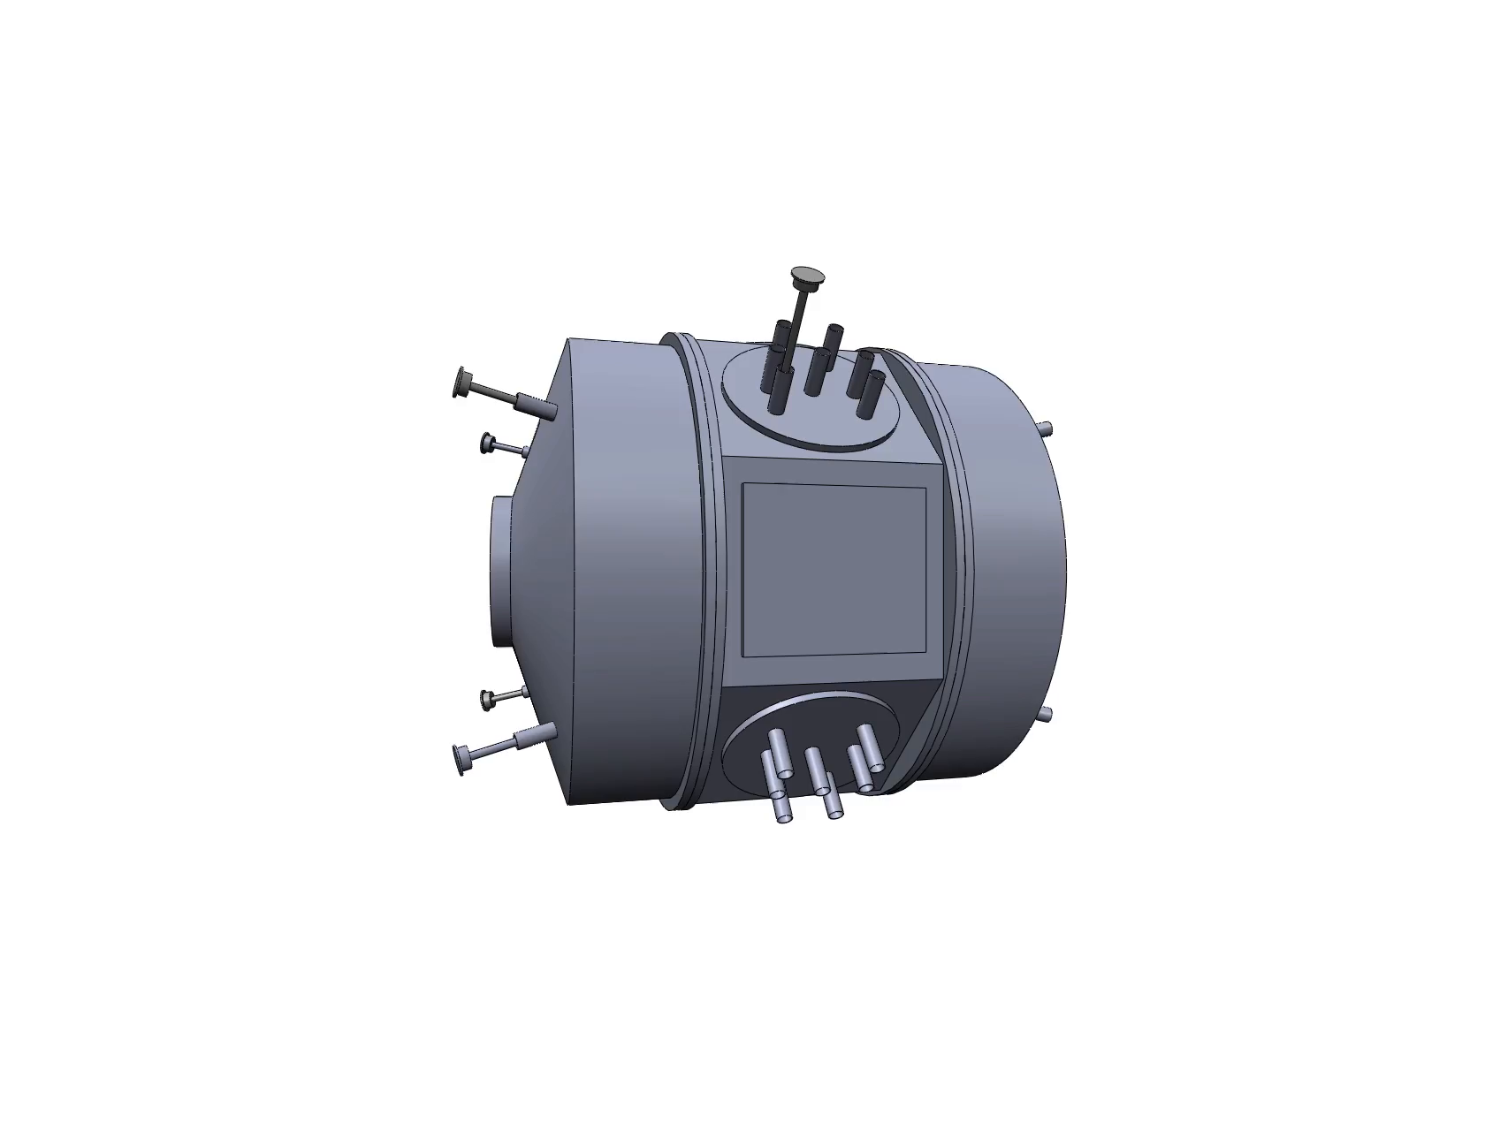
1.5 m

Slide 6
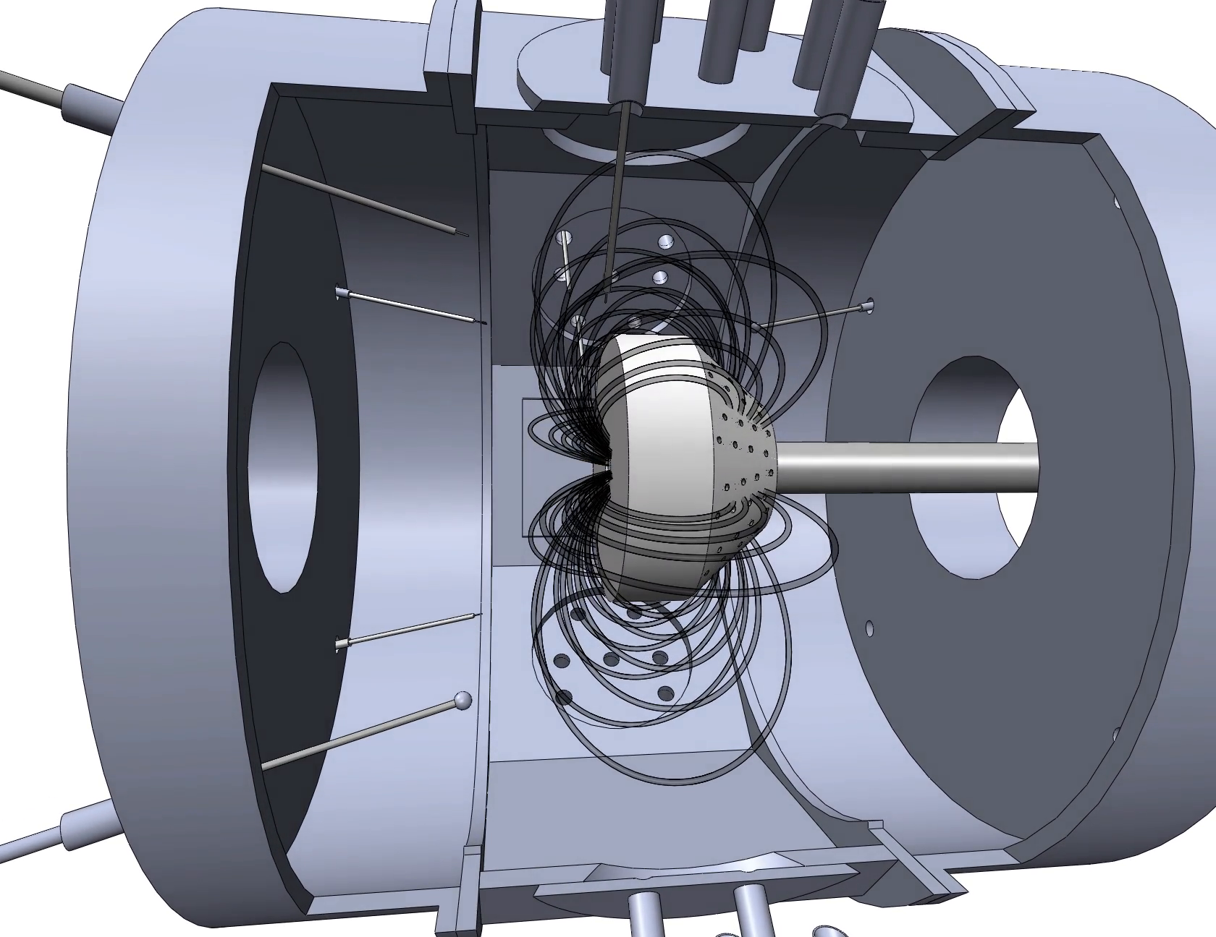

Floating
Probes
I_{sat} Probe
Insulating Boundary
j|| = 0
Floating
Probes
Biasing Electrodes

Slide 7
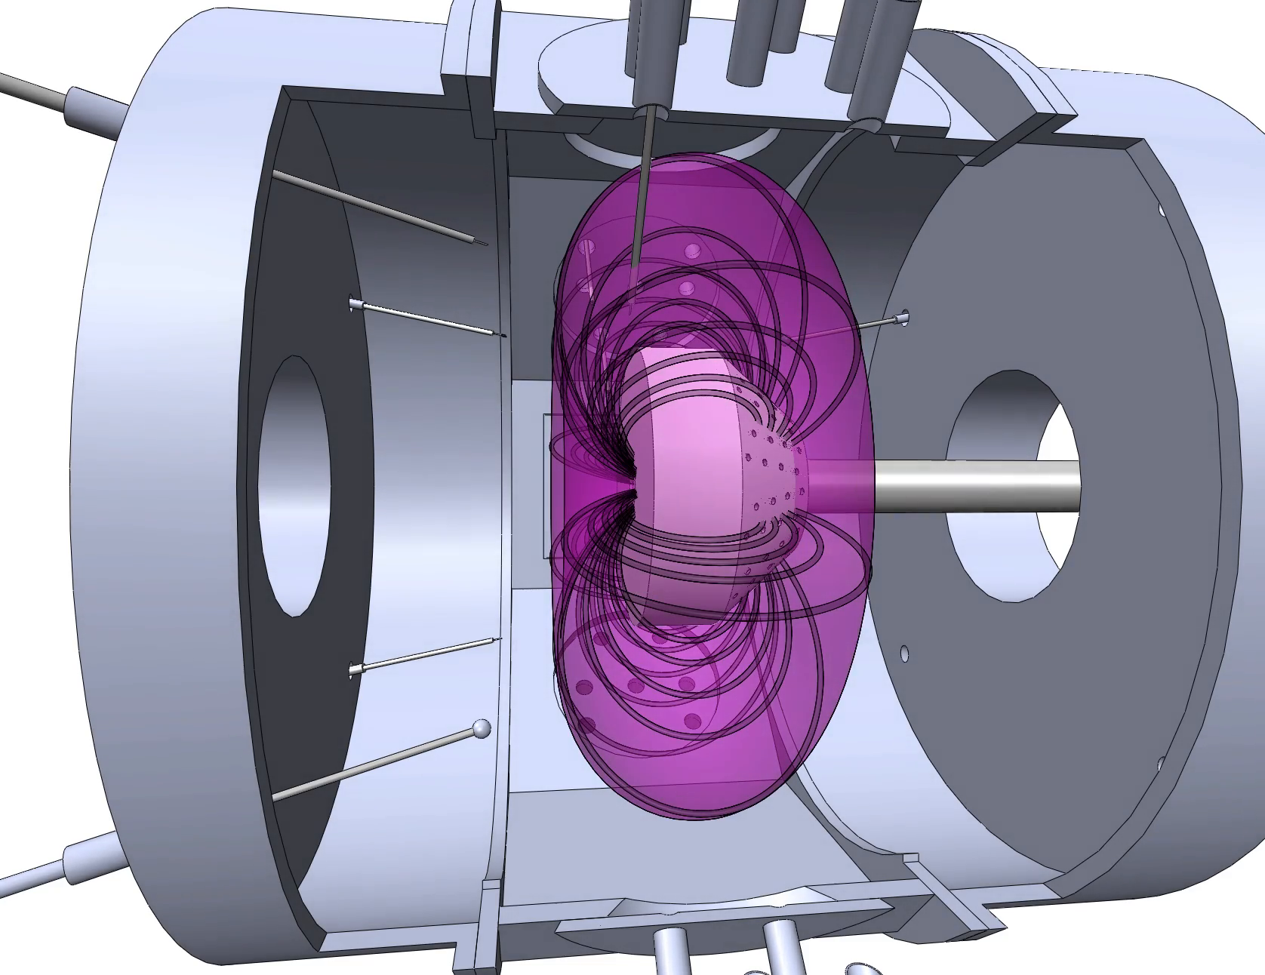
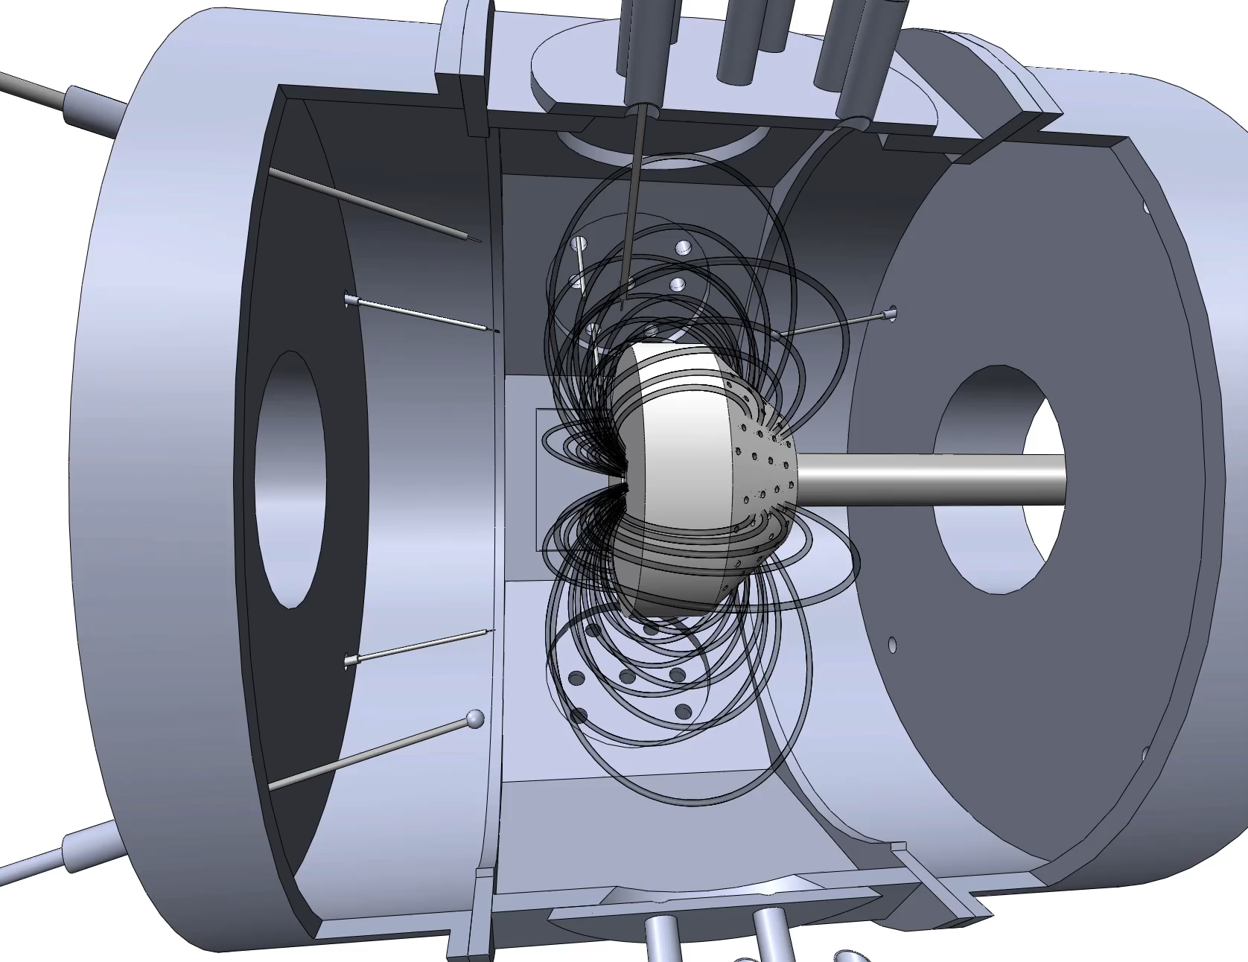
Apply ECRH
T_{e} = 25-50 eV >> T_{i}
n ≈ 10¹¹ cm⁻³

Slide 8
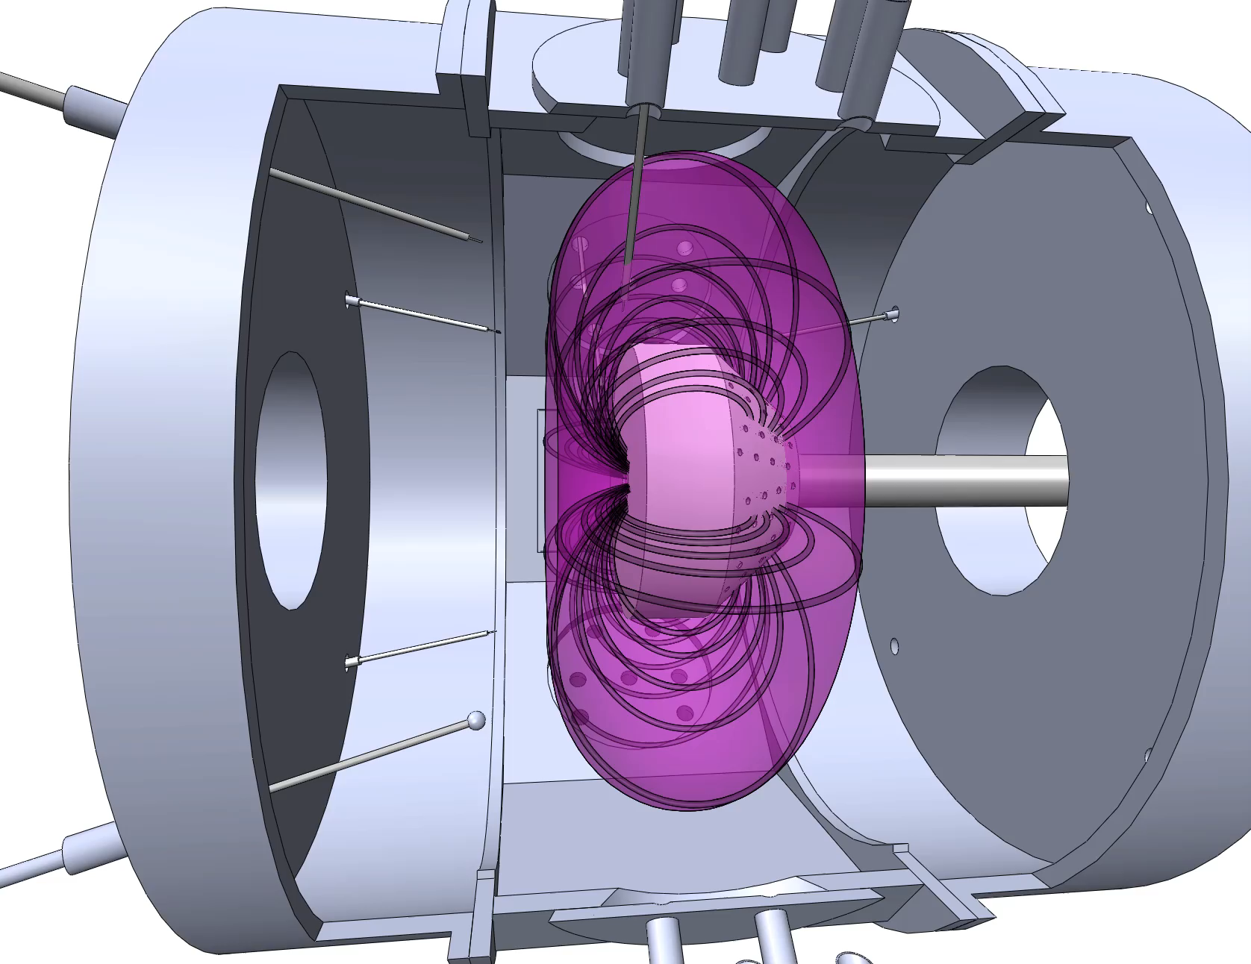
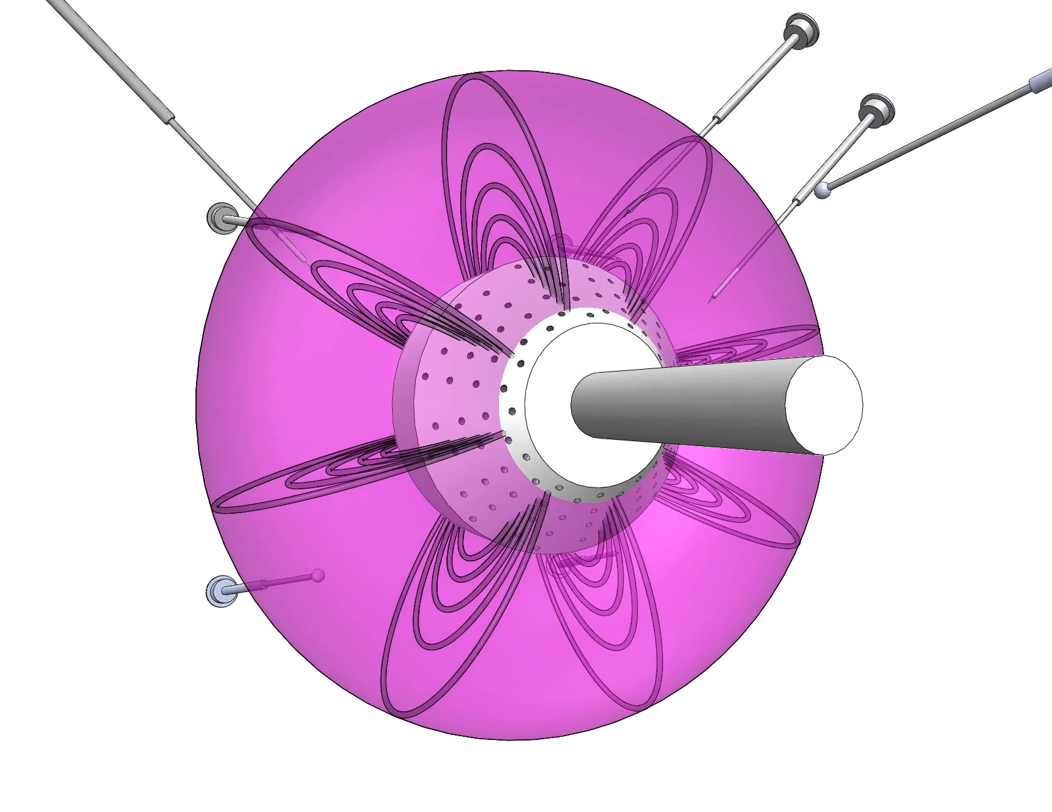
Polar Imaging Array
96 Gridded Energy Analyzers
8 radii w/ 12 toroidal positions
Biased to collect ions lost to pole
Full-plasma imaging

Slide 9
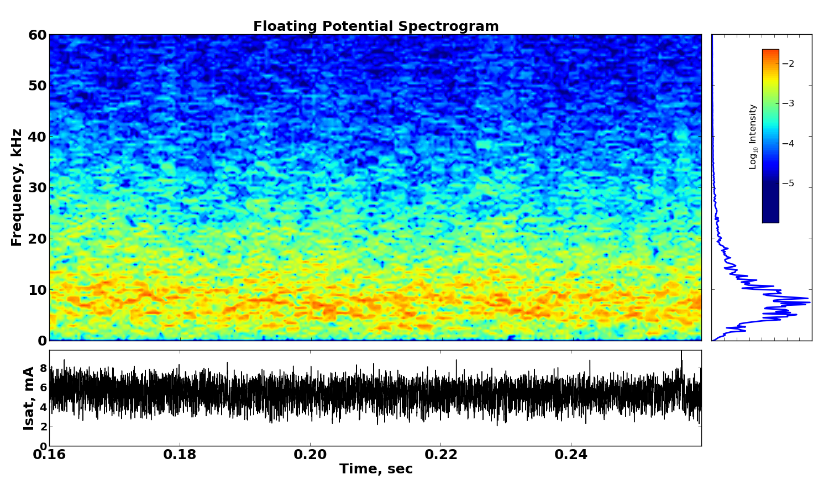
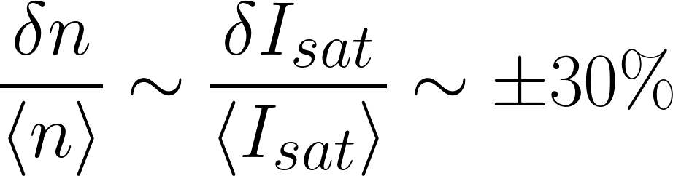
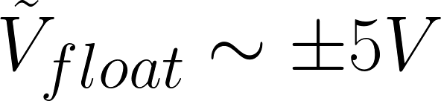
Characteristics of Quasi-Steady Interchange Turbulence
Audio range dynamics
ω_{de}/2π ≈ 2-4 kHz
Electron Magnetic Drift Frequency

Slide 10
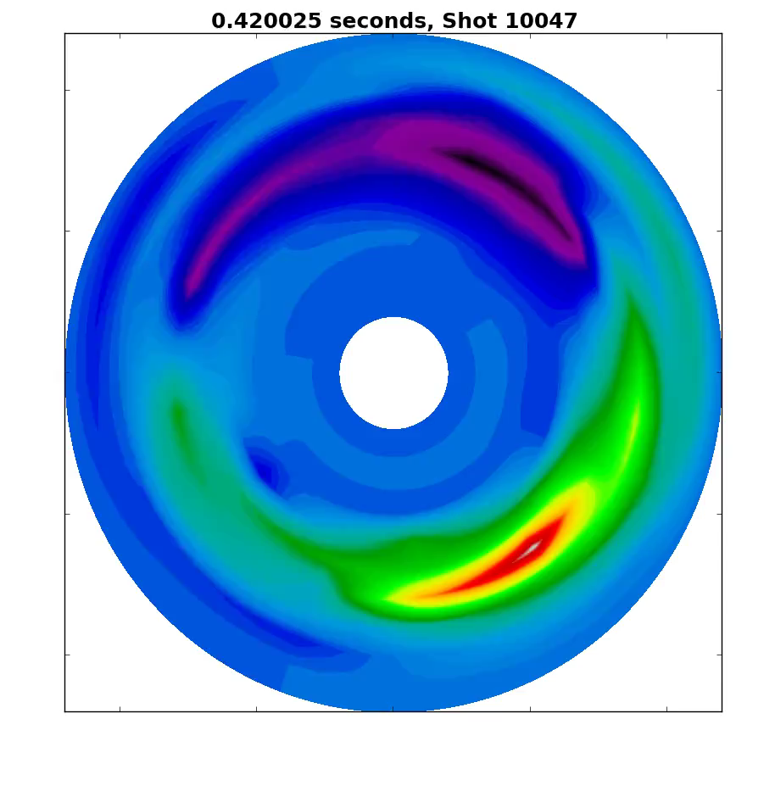
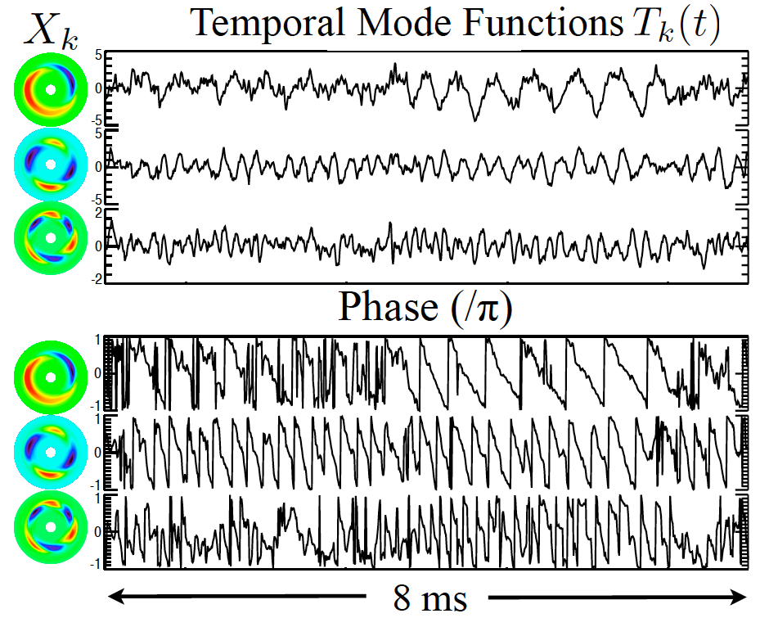
Structure of the Turbulence
Radially broad flute-like modes (k|| ≈ 0)
Low azimuthal mode number, m = 1, 2, 3
Mode rotate with the electron magnetic drift
m
1
2
3
Chaotically varying amplitude and phase
Combined correlation length of 50-75˚
Electron magnetic drift direction

Slide 11
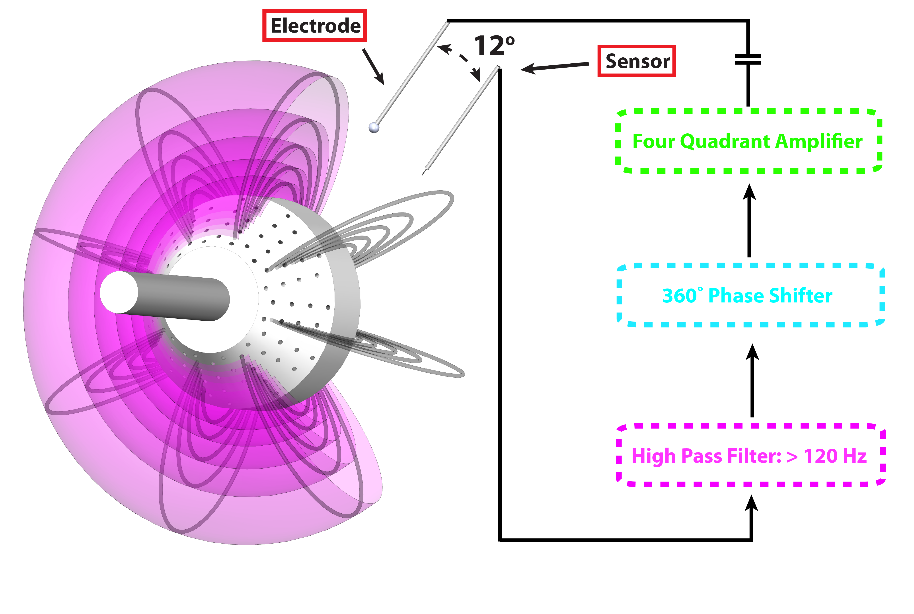
Current-Collection Feedback
Capacitively Coupled

Slide 12
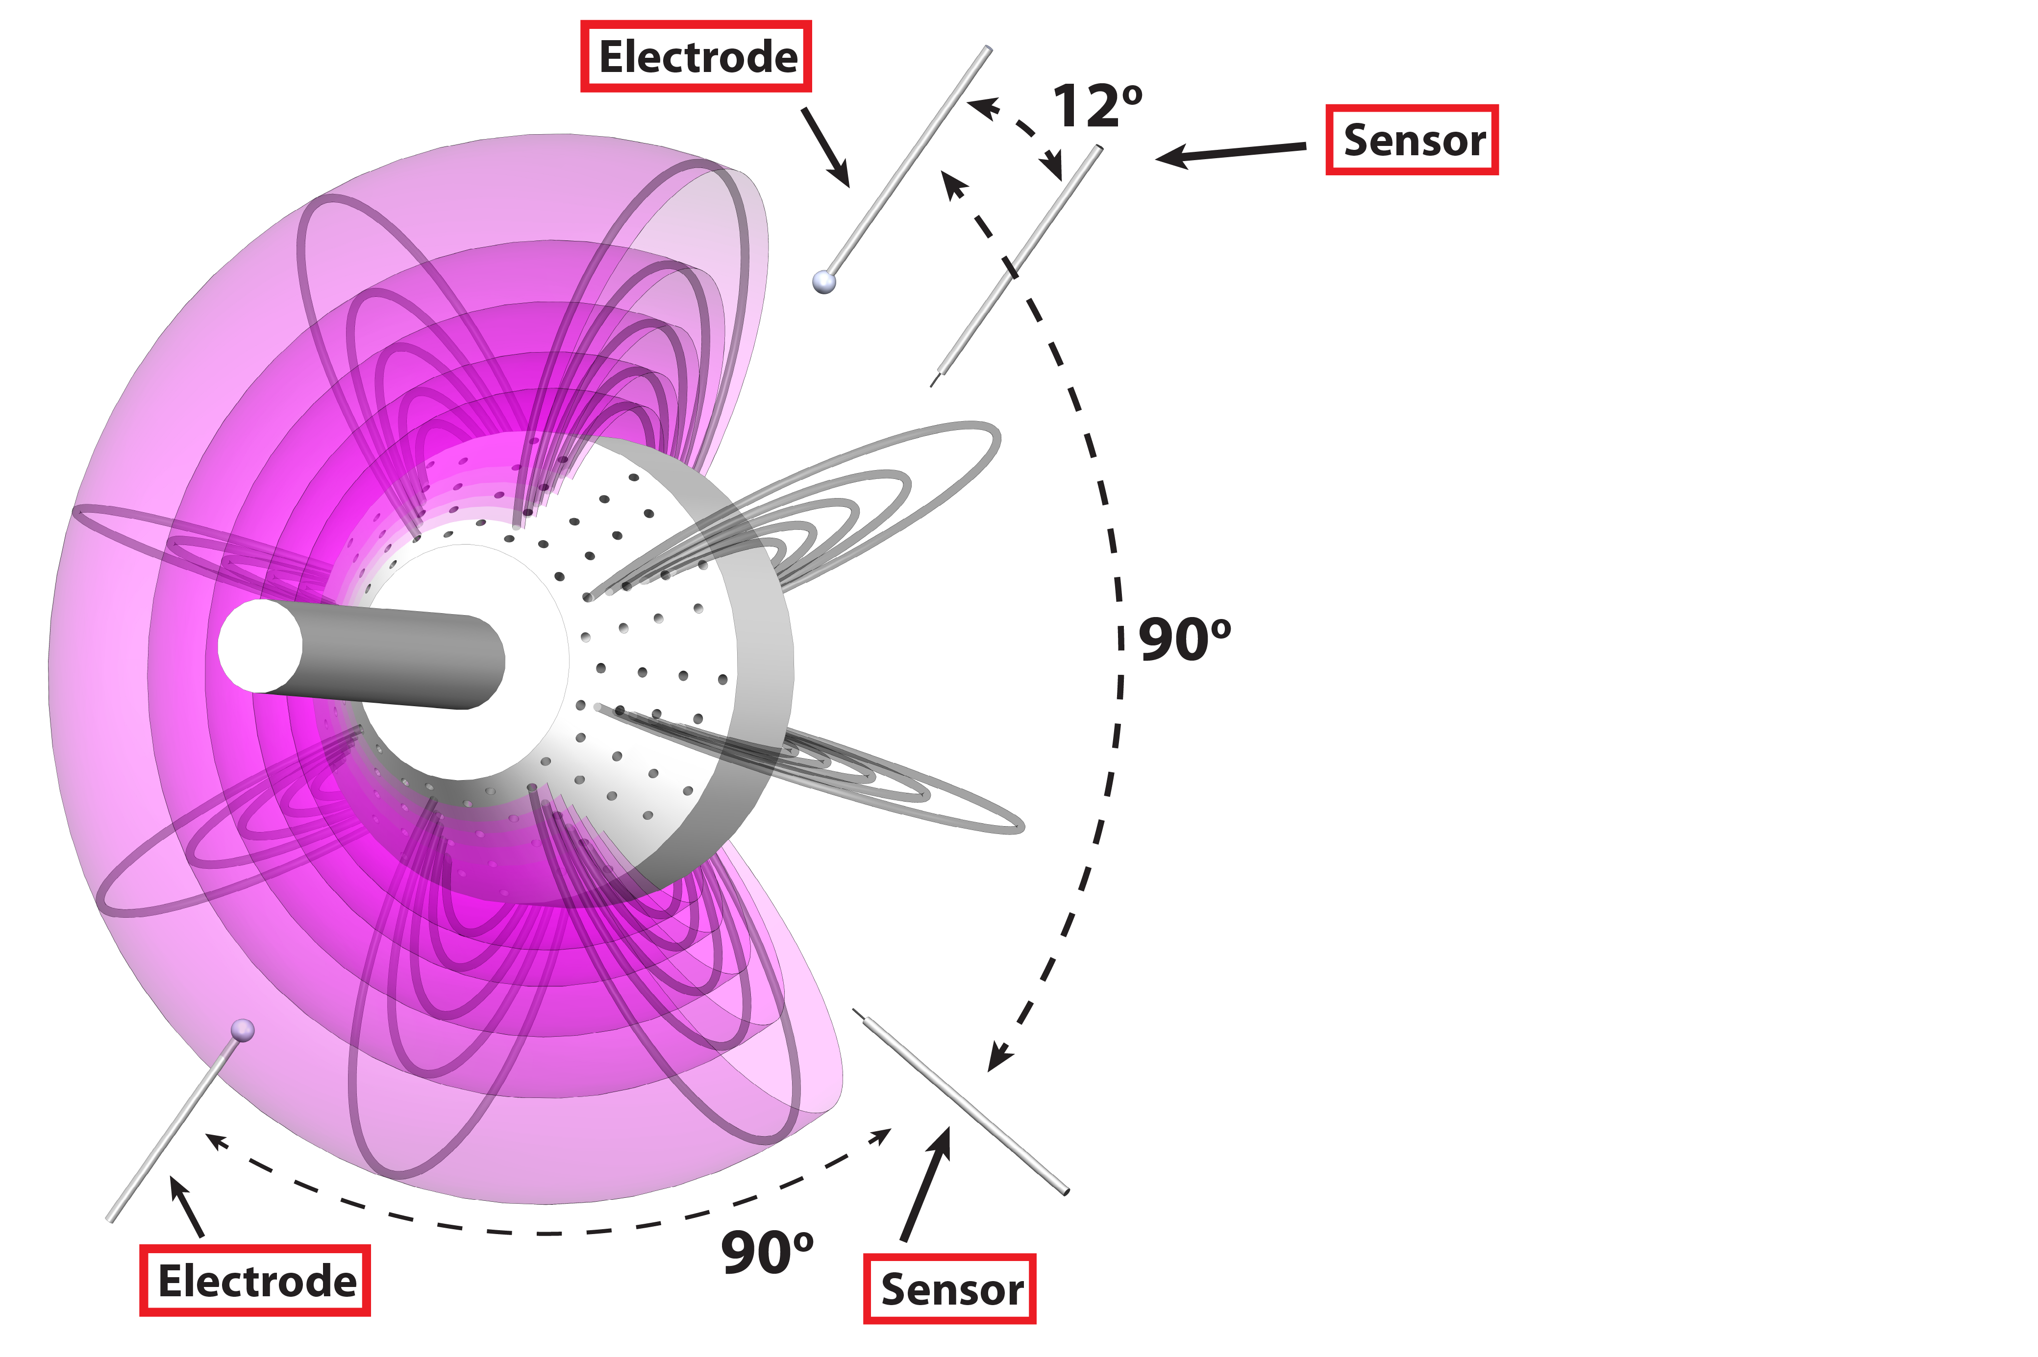
Current-Collection Feedback
Two sensor locations
Two electrode locations

Slide 13
Related Experiments with Feedback
Feedback on Interchange Modes
  Prater applied narrow-band feedback with a biasing electrode to suppress large growth rate flute modes.
  (R. Prater, Phys. Rev. Lett. 27, 132 – July 1971)
Feedback in Turbulent Plasmas
  TEXT group used biasing electrodes to suppress broadband drift wave turbulence in tokamak edge.
  (B. Richards, Phys. Plasmas 1, 1606 (1994))
  (T. Uckan, Nucl. Fusion 35 487 (1995))
The feedback in CTX is different from both of the above cases:
  Broadband feedback is applied to global interchange
  turbulence in the magnetospheric configuration.

Slide 14
Current-Collection Experiments
Plasma responds to coherent current-collection (feedforward)
Triggering feedback on and off shows amplification and suppression of fluctuations and a localized effect.
Varying the gain and phase of the current relative to the floating potential significantly changes the spectrum.
Varying the separation between the sensor and electrode shows the effect of decorrelation on feedback influence.

Slide 15
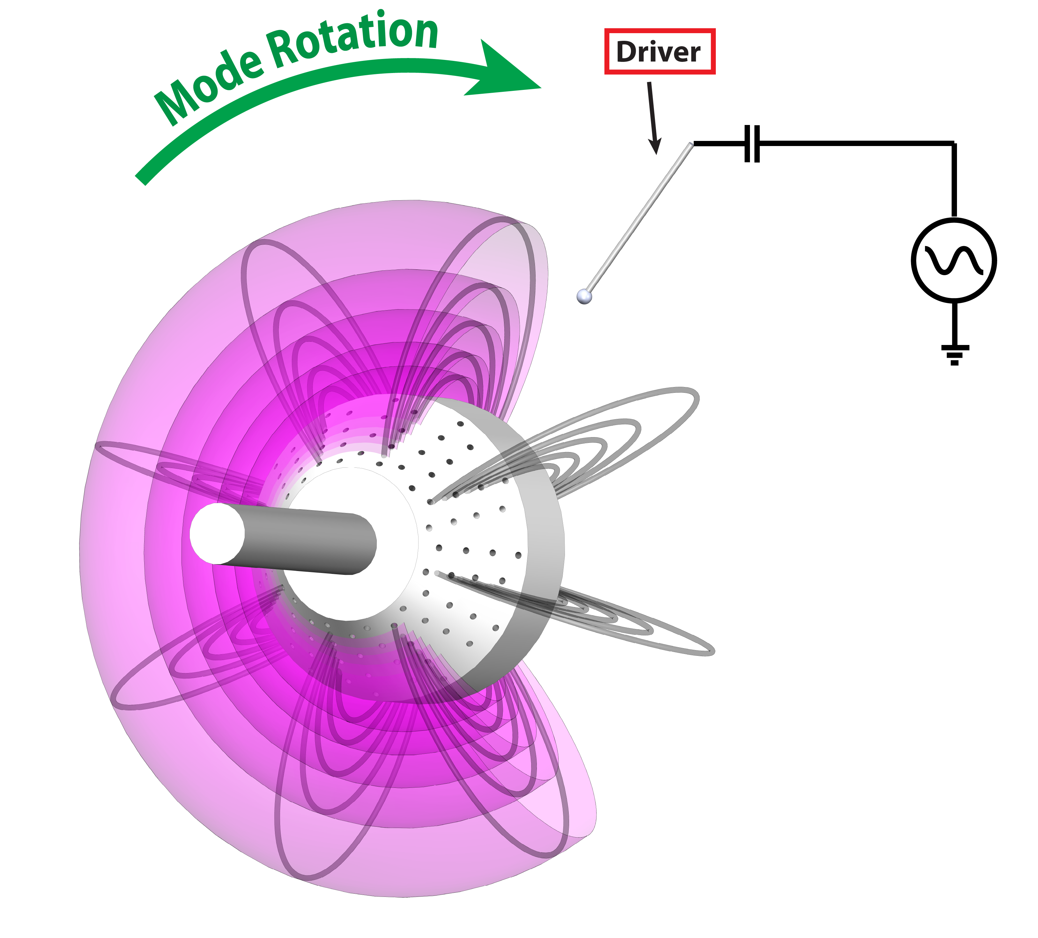
Driving a Coherent Current Oscillation
Electrode biased with 4 kHz sine wave, ±40 V
Downstream: Plasma has moved past electrode
Upstream: Plasma has yet to move past electrode

Slide 16
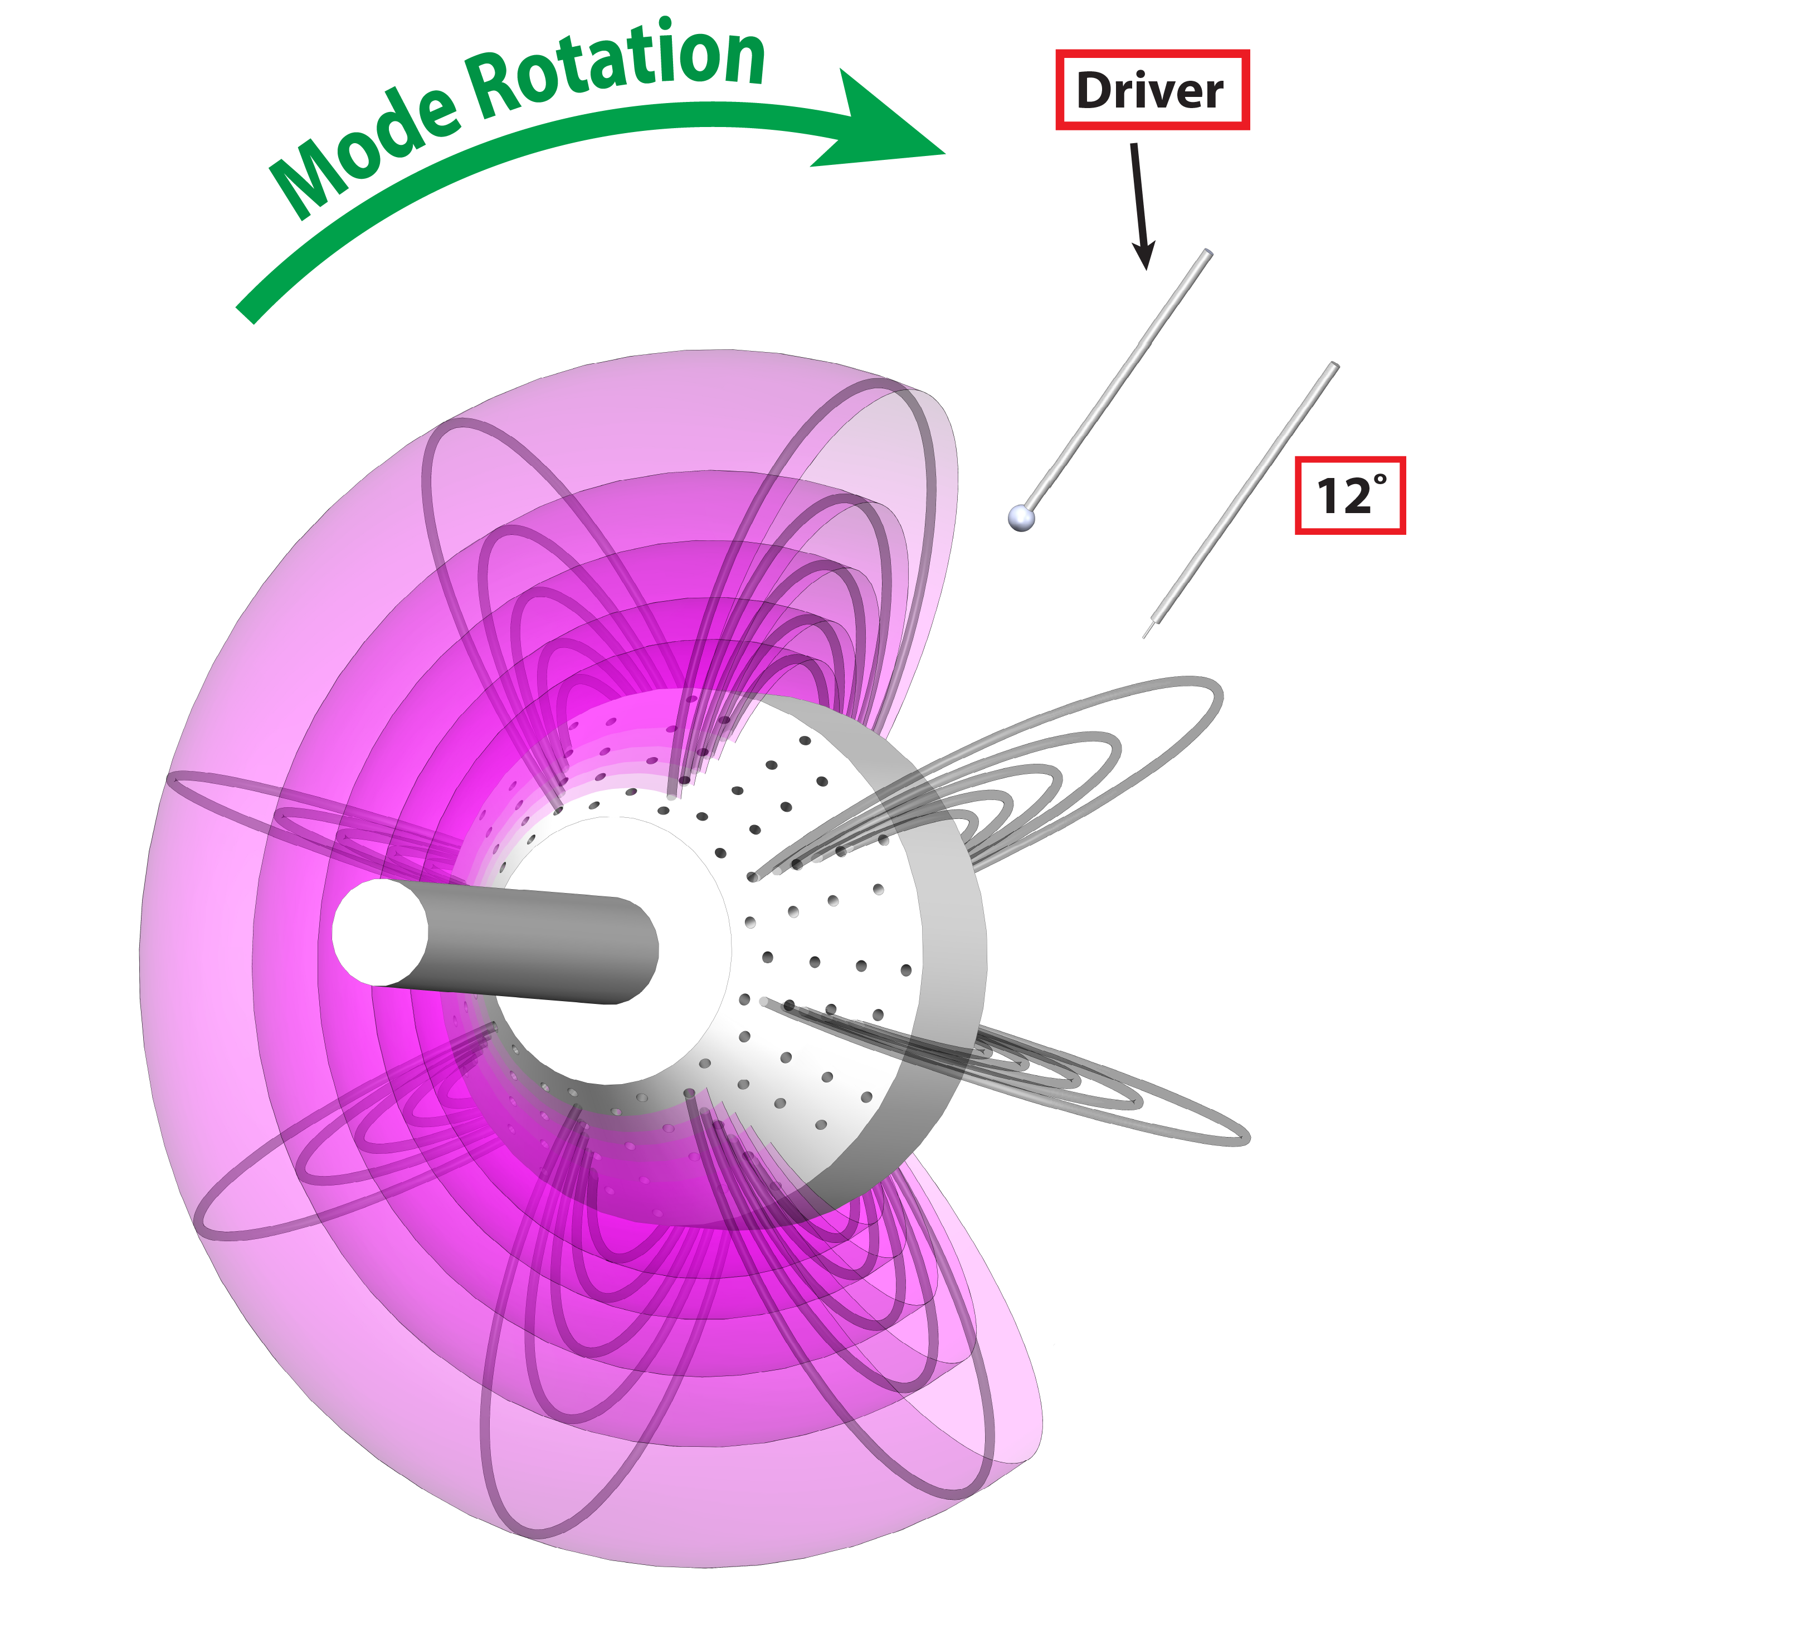
Driving a Coherent Current Oscillation
Electrode biased with 4 kHz sine wave, ±40 V

Slide 17
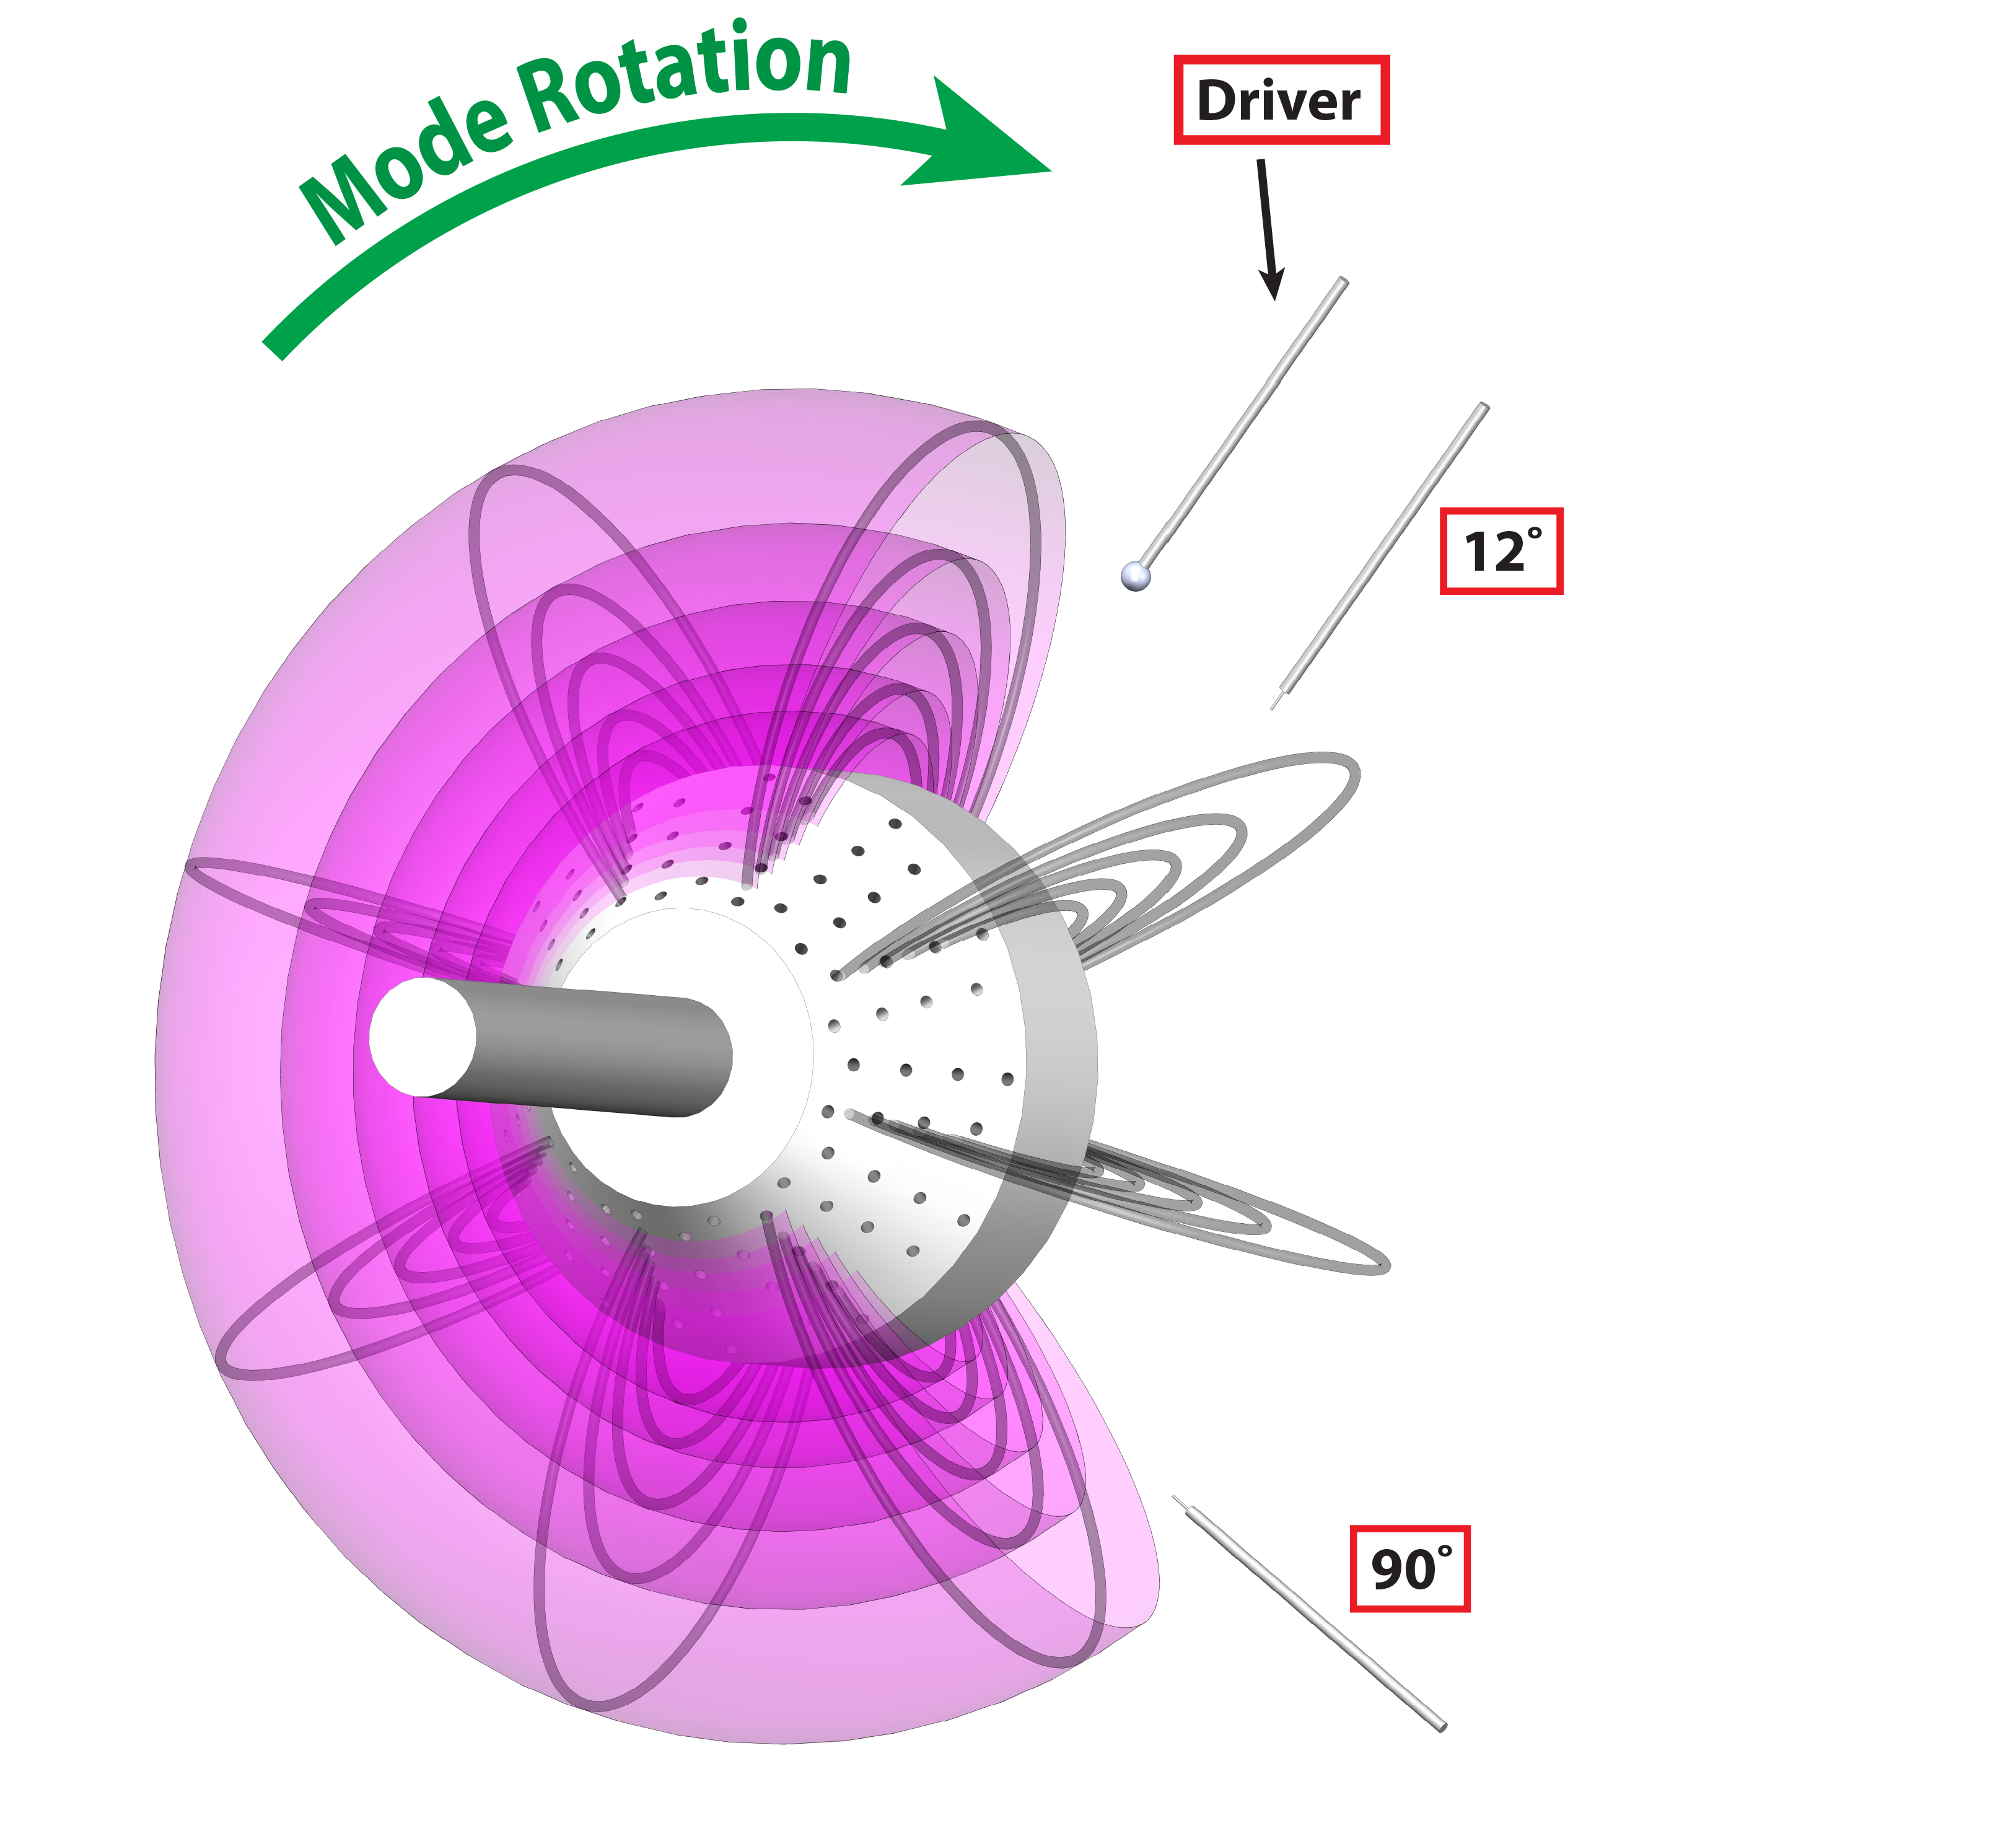
Driving a Coherent Current Oscillation
Electrode biased with 4 kHz sine wave, ±40 V

Slide 18
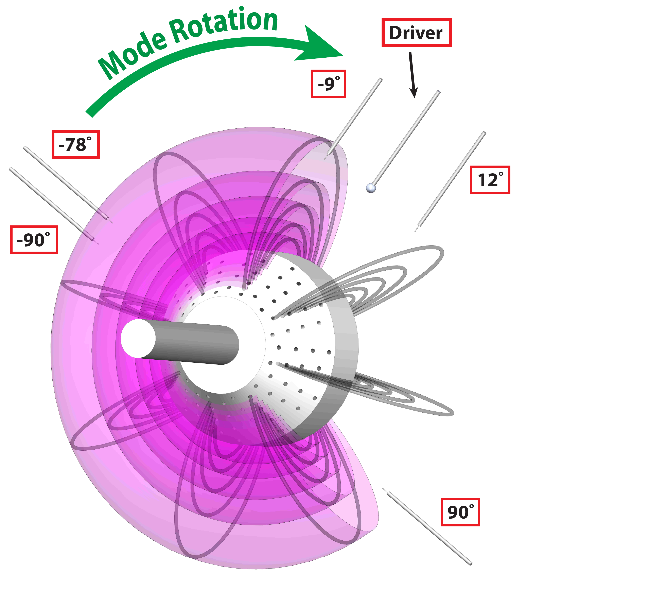
Driving a Coherent Current Oscillation
upstream
Electrode biased with 4 kHz sine wave, ±40 V
Launches coherent wave in direction of mode rotation
Downstream influence significantly greater
downstream
Mode Rotation

Slide 19
Current-Collection Experiments
Plasma responds to coherent current-collection (feedforward)
Triggering feedback on and off shows amplification and suppression of fluctuations and a localized effect.
Varying the gain and phase of the current relative to the floating potential significantly changes the spectrum.
Varying the separation between the sensor and electrode shows the effect of decorrelation on feedback influence.

Slide 20
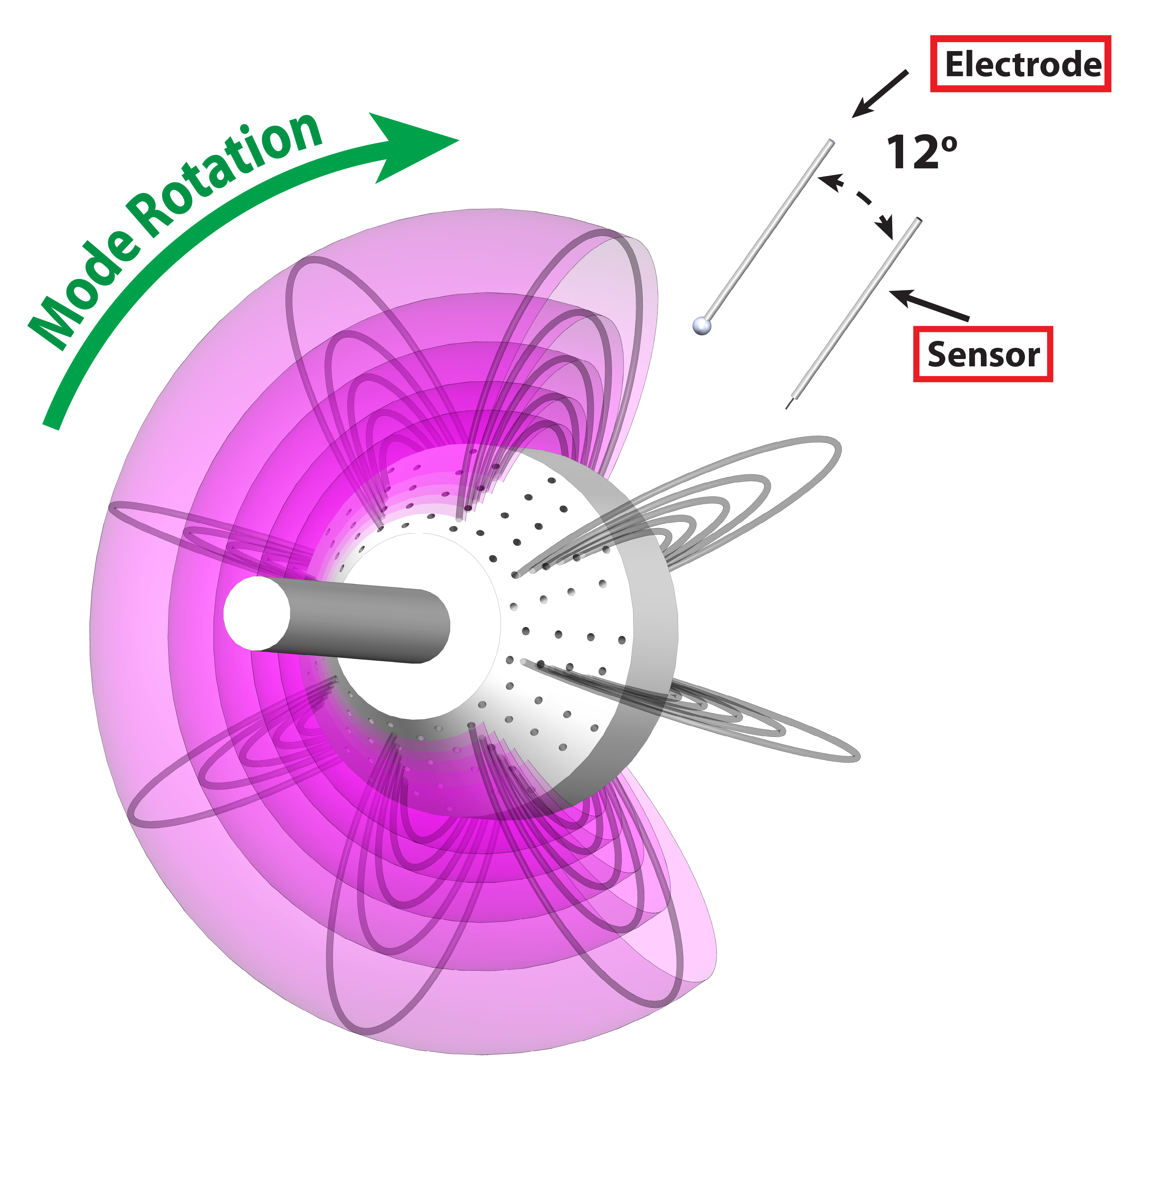
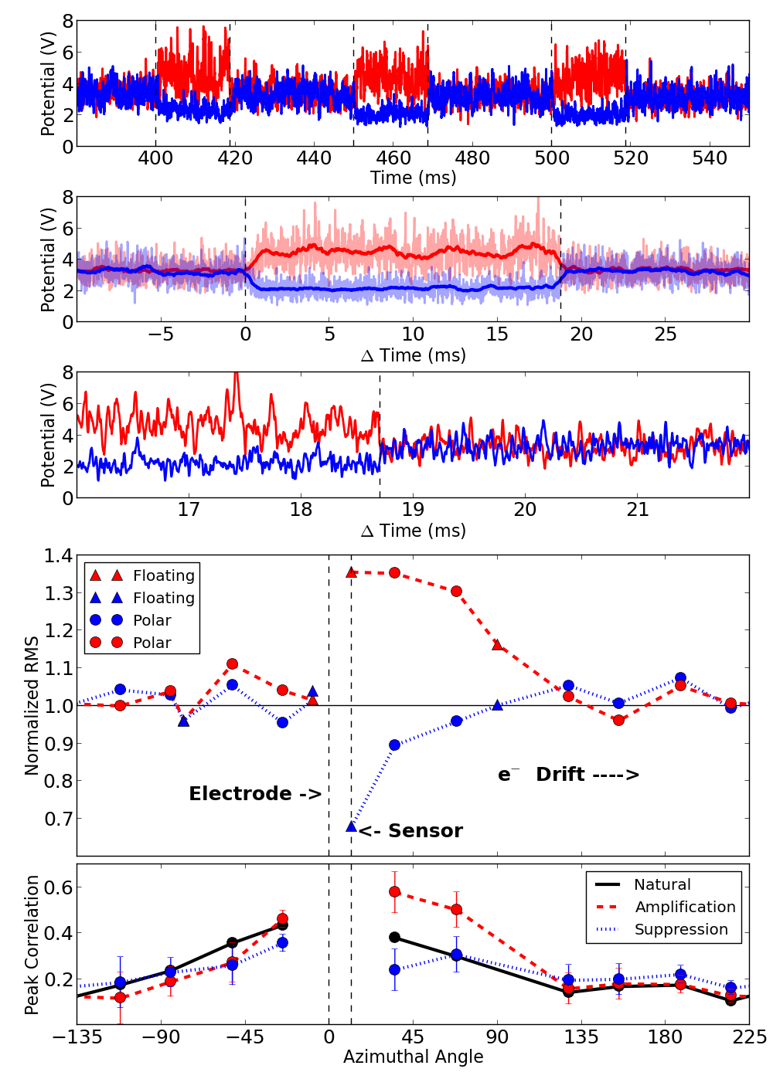
Triggered Feedback Show Amplification and Suppression
G = ± 4
Amplification -> + 30%
Suppression -> -30%
Relaxation time < 20 us
OFF
ON
OFF
ON
OFF
ON
OFF
OFF
ON
OFF
Moving RMS Fluctuations of Floating Potential
ON
OFF
Averaging of triggering events

Slide 21
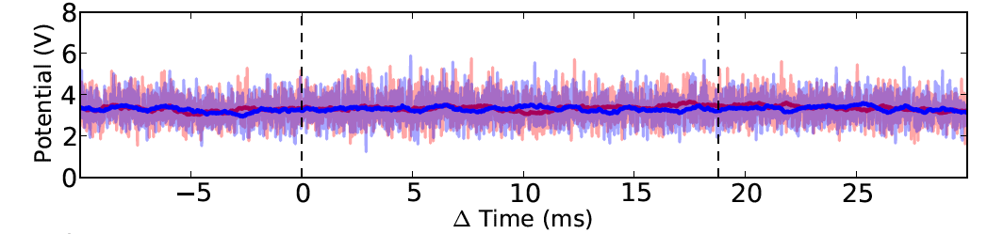
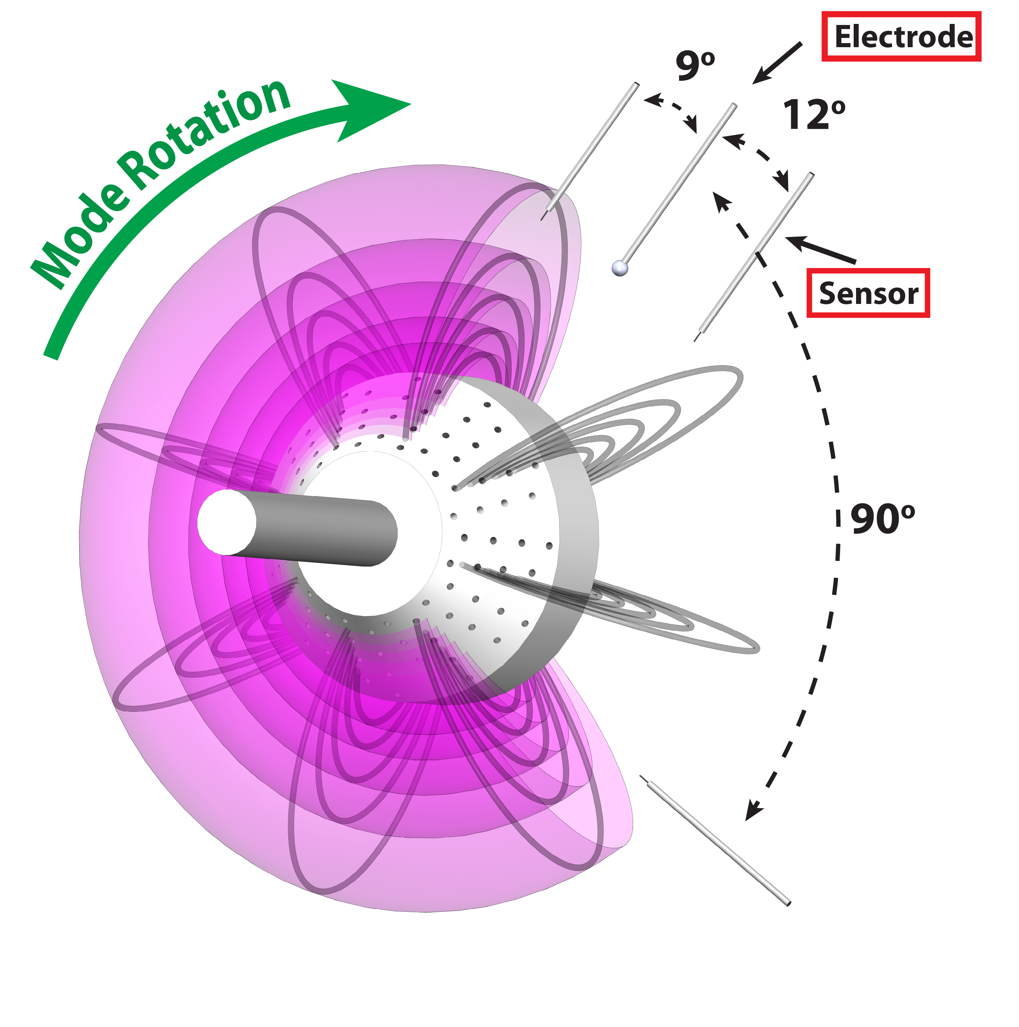
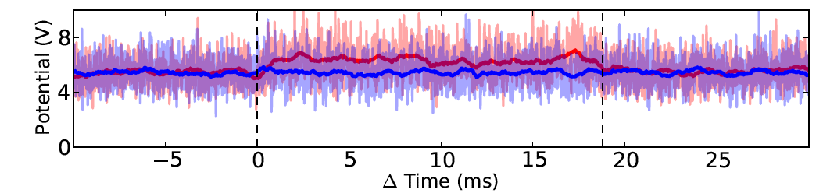
Influence Diminishes with Azimuthal Separation
OFF
  9˚
ON
OFF
  Nearby “upstream” probe sees no response
  12˚
OFF
ON
OFF
OFF
  90˚
ON
OFF
  “Downstream” probe sees reduced response

Slide 22
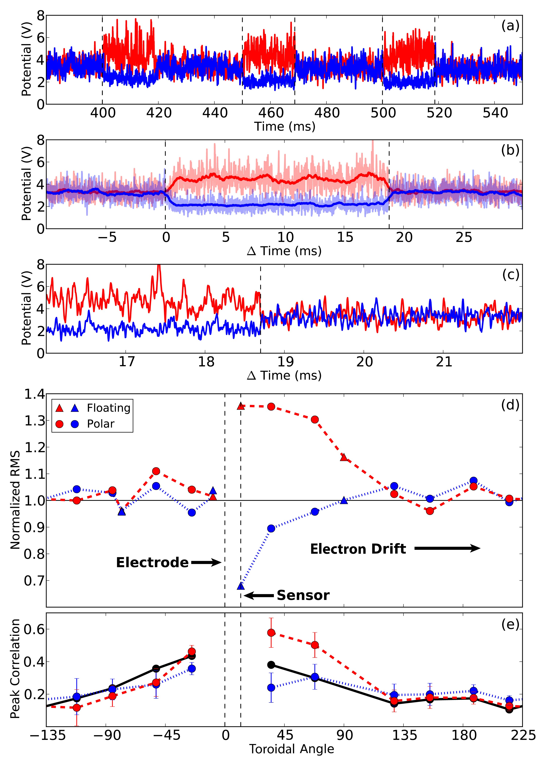
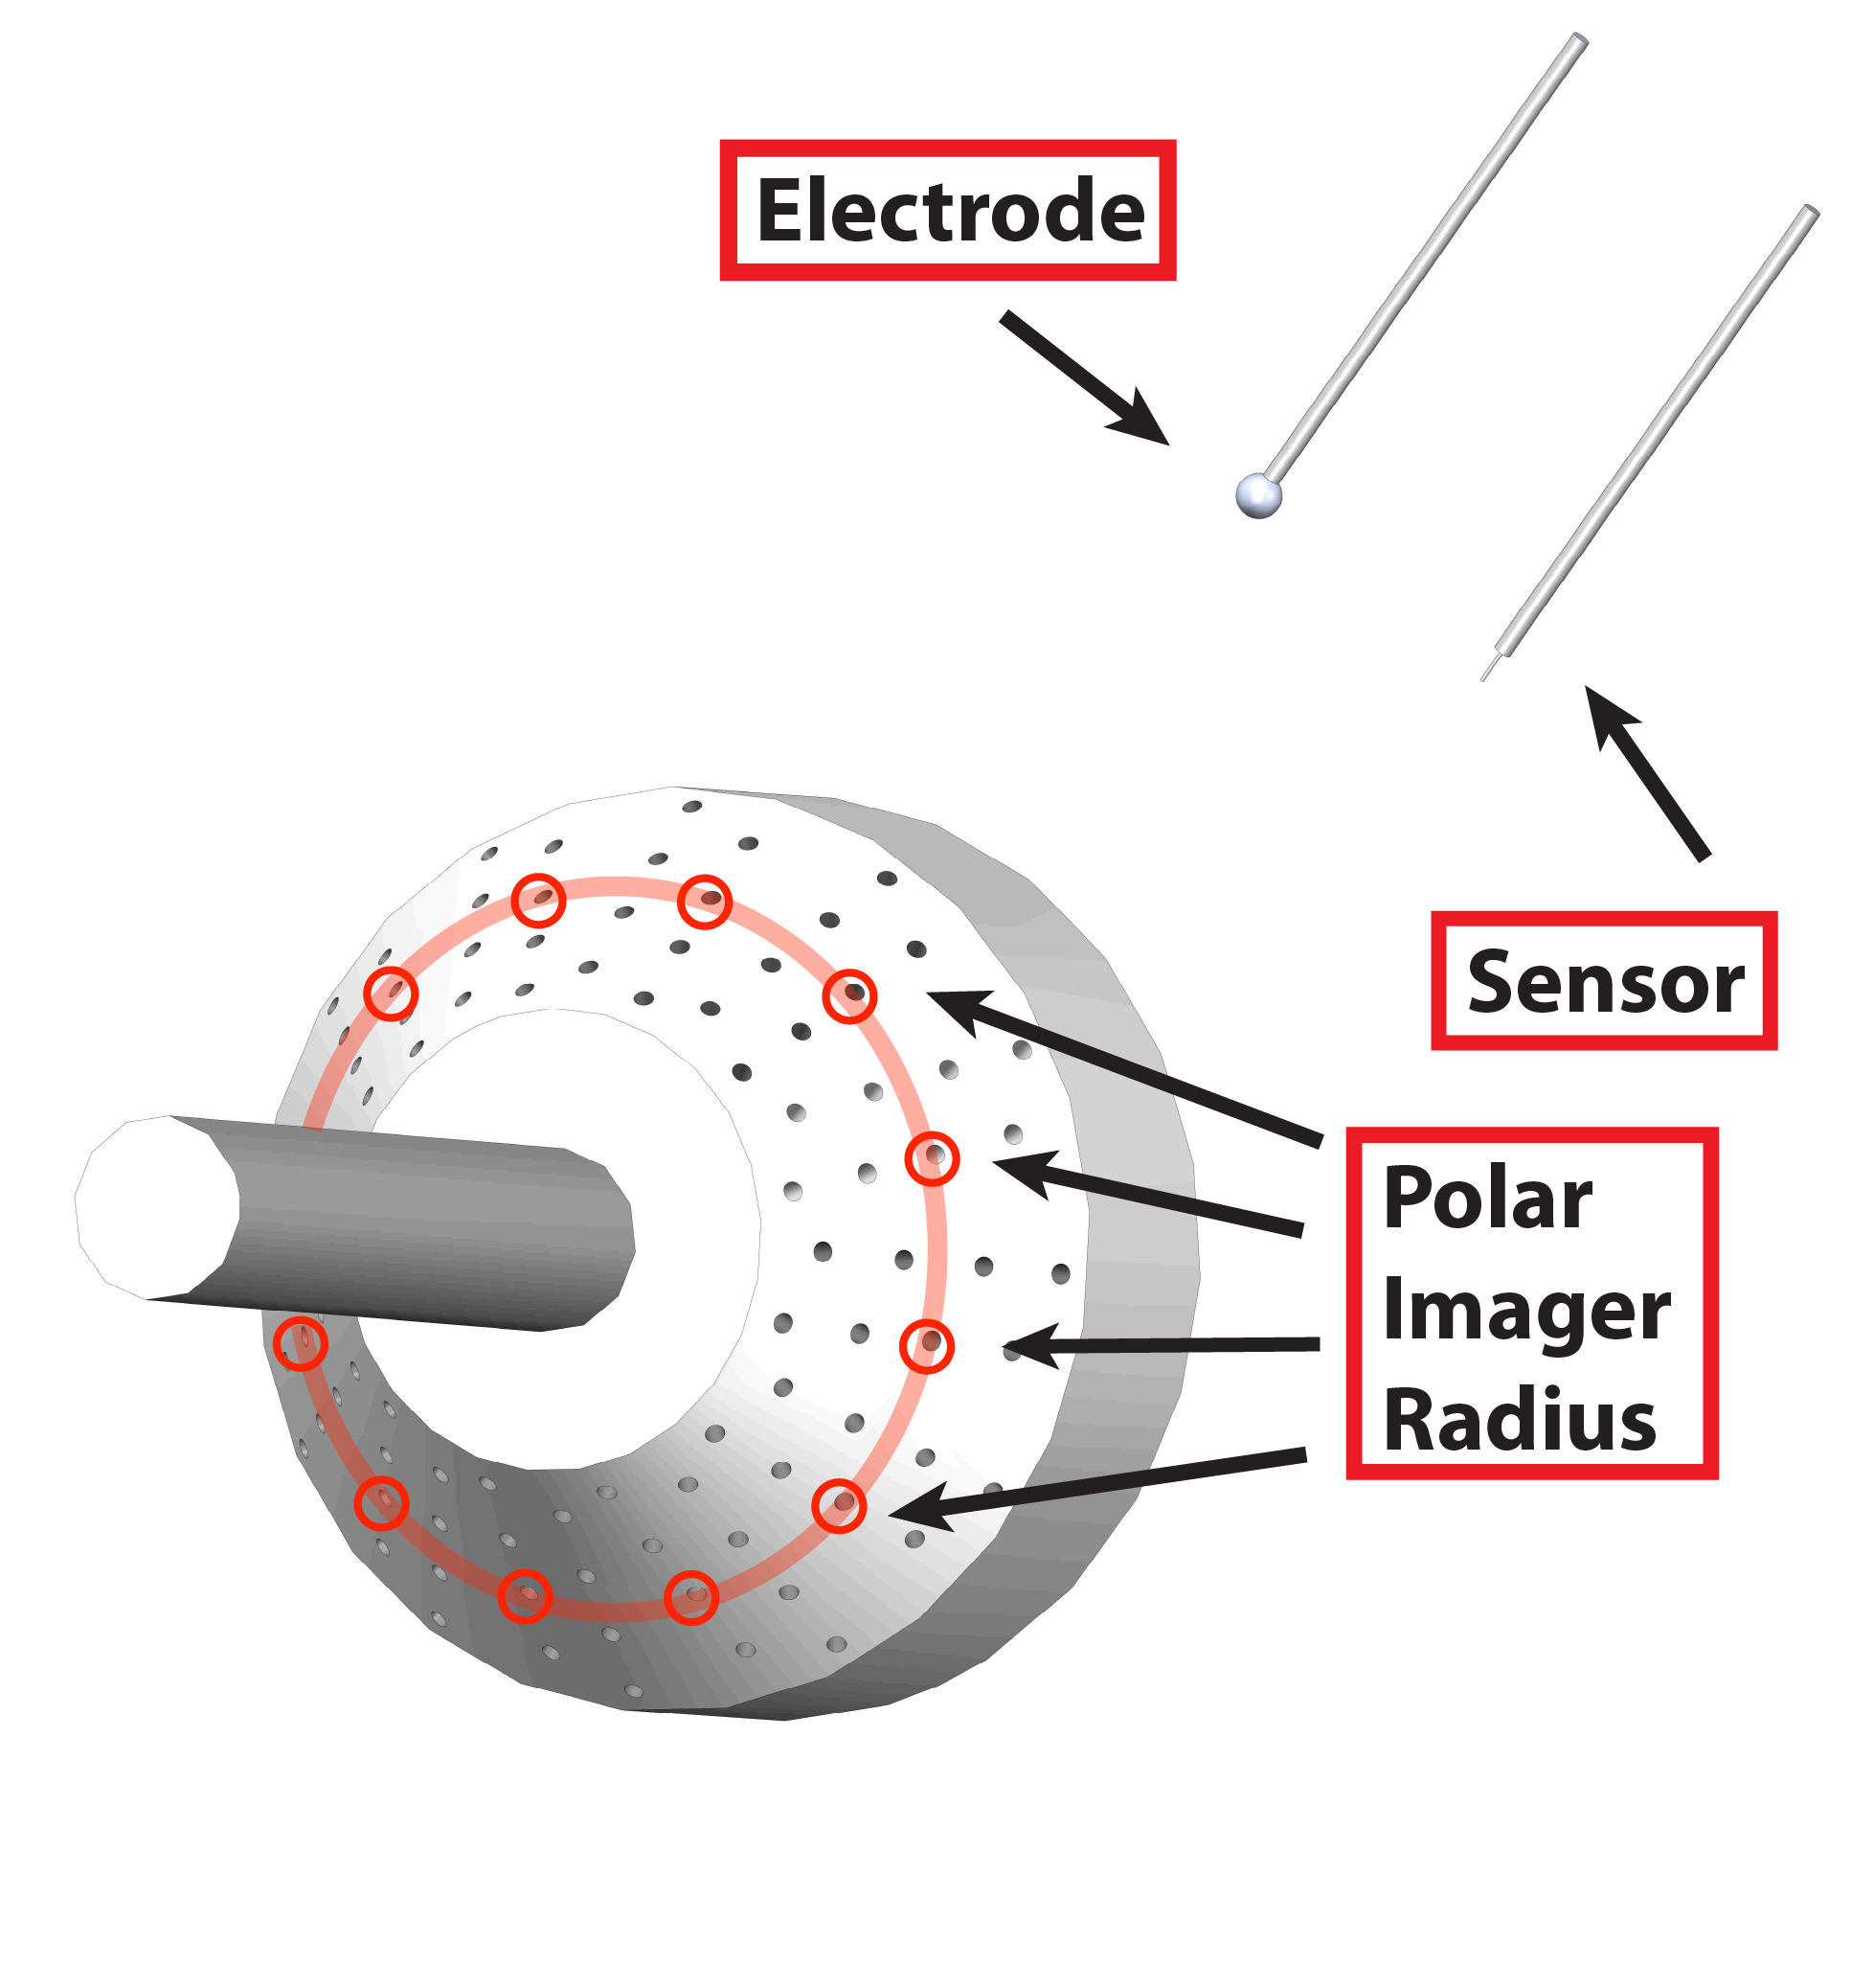
Influence of Feedback is Spatially Localized
RMS normalized to “natural” values
No influence in the direction opposite to mode rotation
Azimuthal Angle

Slide 23
Feedback Increases or Decreases Correlation
Azimuthal Angle

Slide 24
Feedback Increases or Decreases Correlation
Correlation stronger with positive feedback, reduced with negative feedback
Azimuthal Angle

Slide 25
Current-Collection Experiments
Plasma responds to coherent current-collection (feedforward)
Triggering feedback on and off shows amplification and suppression of fluctuations and a localized effect.
Varying the gain and phase of the current relative to the floating potential significantly changes the spectrum.
Varying the separation between the sensor and electrode shows the effect of decorrelation on feedback influence.

Slide 26
Turbulent Spectrum Shows Influence of Feedback

Slide 27
Turbulent Spectrum Shows Influence of Feedback

Slide 28
Turbulent Spectrum Shows Influence of Feedback

Slide 29
Changing Turbulent Spectrum with Phase
Fixed gain of 4
Amplified
Band Integrated (1-10 kHz)
Spectral Intensity
Suppressed
Suppressed

Slide 30
Changing Turbulent Spectrum with Phase
Fixed gain of 4
Frequency of amplified modes changes with phase
Faster
Intensity Weighted Frequency (1-10 kHz)
Slower

Slide 31
Gain Scan: +G -> Amplification, -G -> Suppression
Phased for peak suppression
Phased for peak amplification
Amplified
Band Integrated (1-10 kHz)
Spectral Intensity
Suppressed

Slide 32
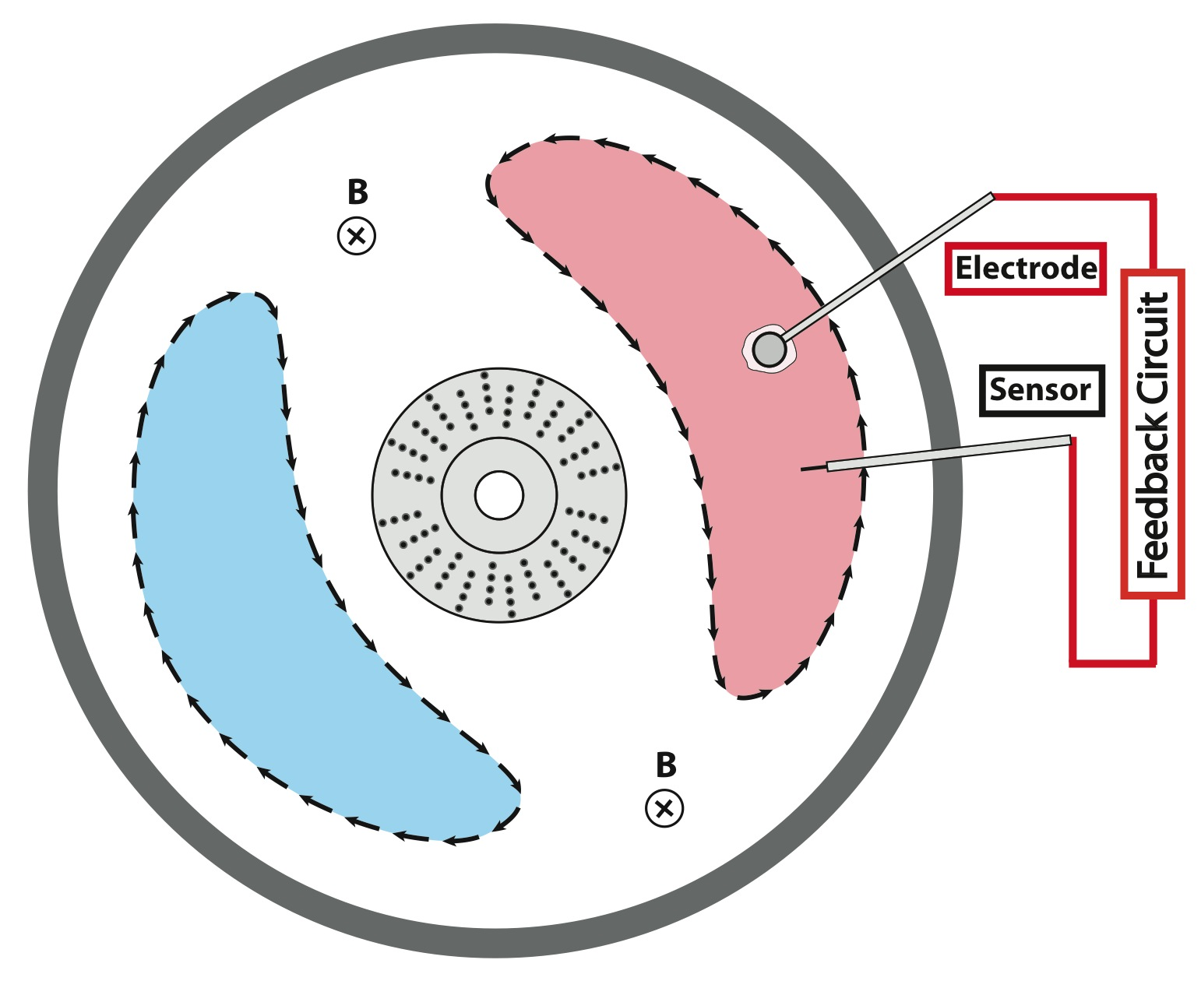
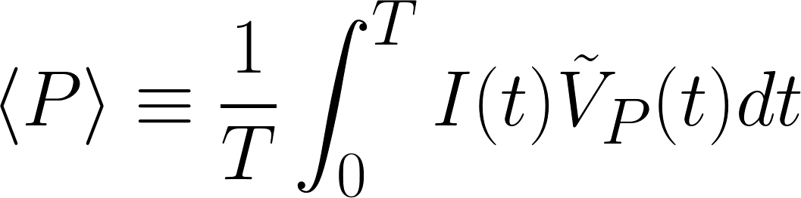
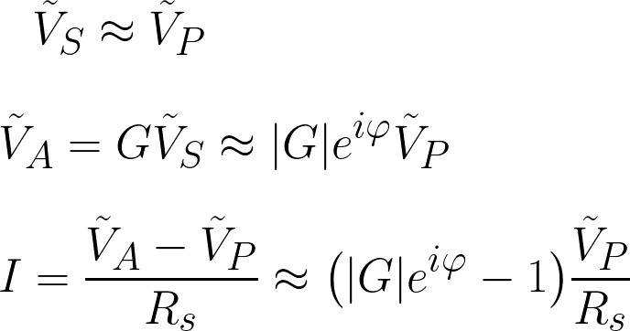
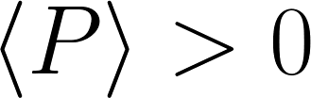
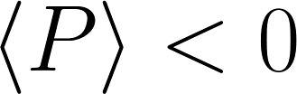
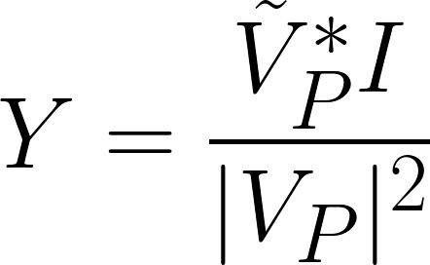
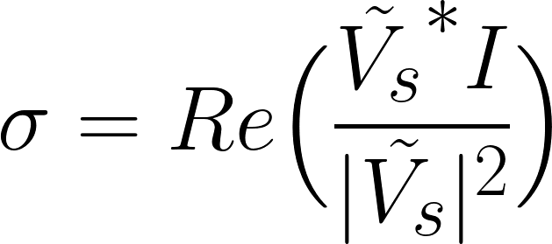
Defining Power and Conductance
Time Average Power
Power into plasma
Power out of plasma
Like the magnetosphere!
Spectral Power Flow: Conductance
Admittance
Conductance

Slide 33


Sign of Conductance Determines Power Flow
Suppression where
Amplification where
Load
Band Integrated (1-10 kHz)
Spectral Intensity
Generator
Band Averaged (1-10 kHz)
Conductance

Slide 34
Current-Collection Experiments
Plasma responds to coherent current-collection (feedforward)
Triggering feedback on and off shows amplification and suppression of fluctuations and a localized effect.
Varying the gain and phase of the current relative to the floating potential significantly changes the spectrum.
Varying the separation between the sensor and electrode shows the effect of decorrelation on feedback influence.

Slide 35
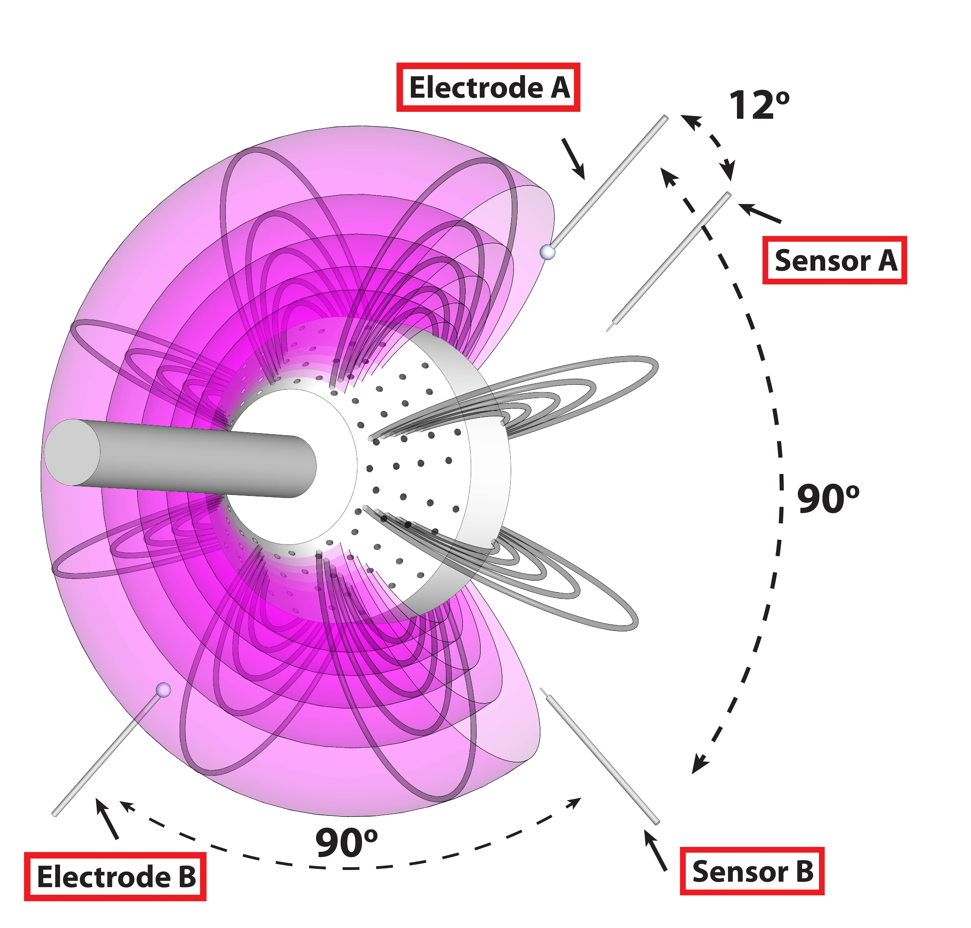
Varying the Separation between the Sensor and Electrode
Adjust the toroidal separation
  Reposition sensor/electrodes
  Reverse mode direction

Slide 36
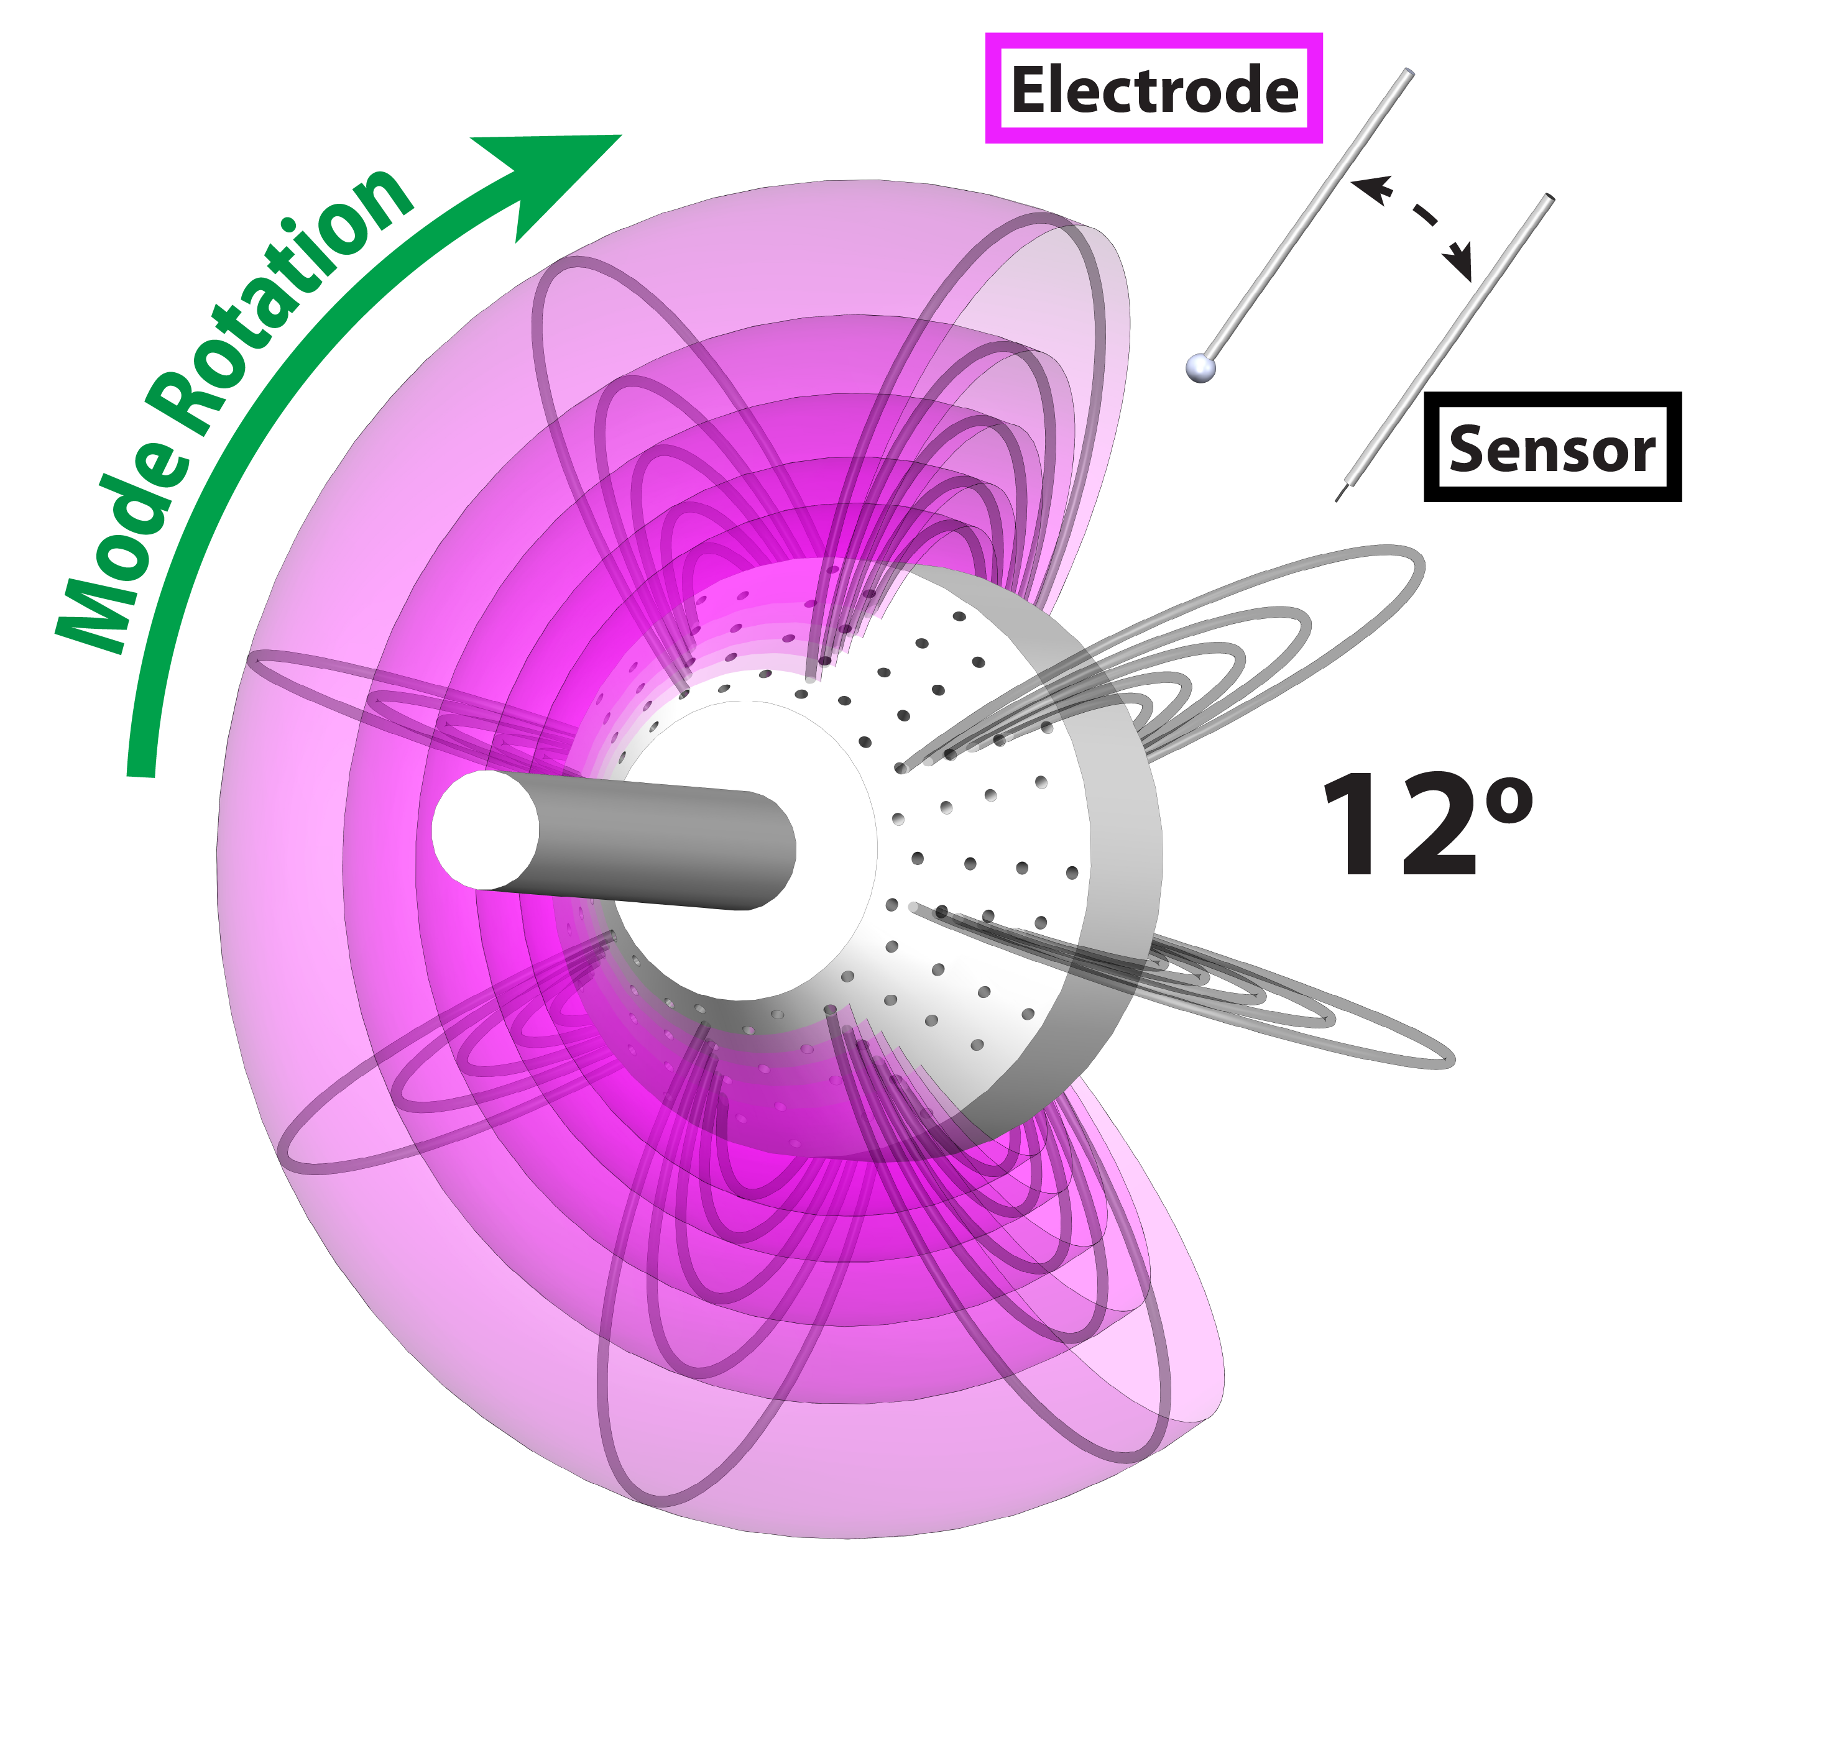
Varying the Separation between the Sensor and Electrode
peak suppression
peak amplification
Fixed gain of 4
Electrode leading the sensor

Slide 37
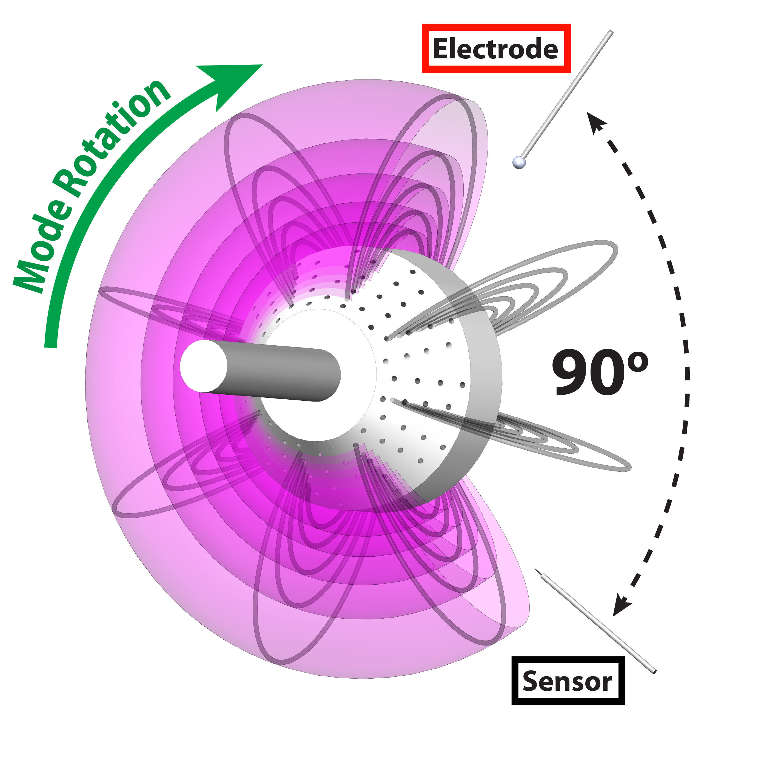
Varying the Separation between the Sensor and Electrode
peak amplification
peak suppression
Shift in phase of peak amplification and suppression
Reduced response, particularly in suppression

Slide 38
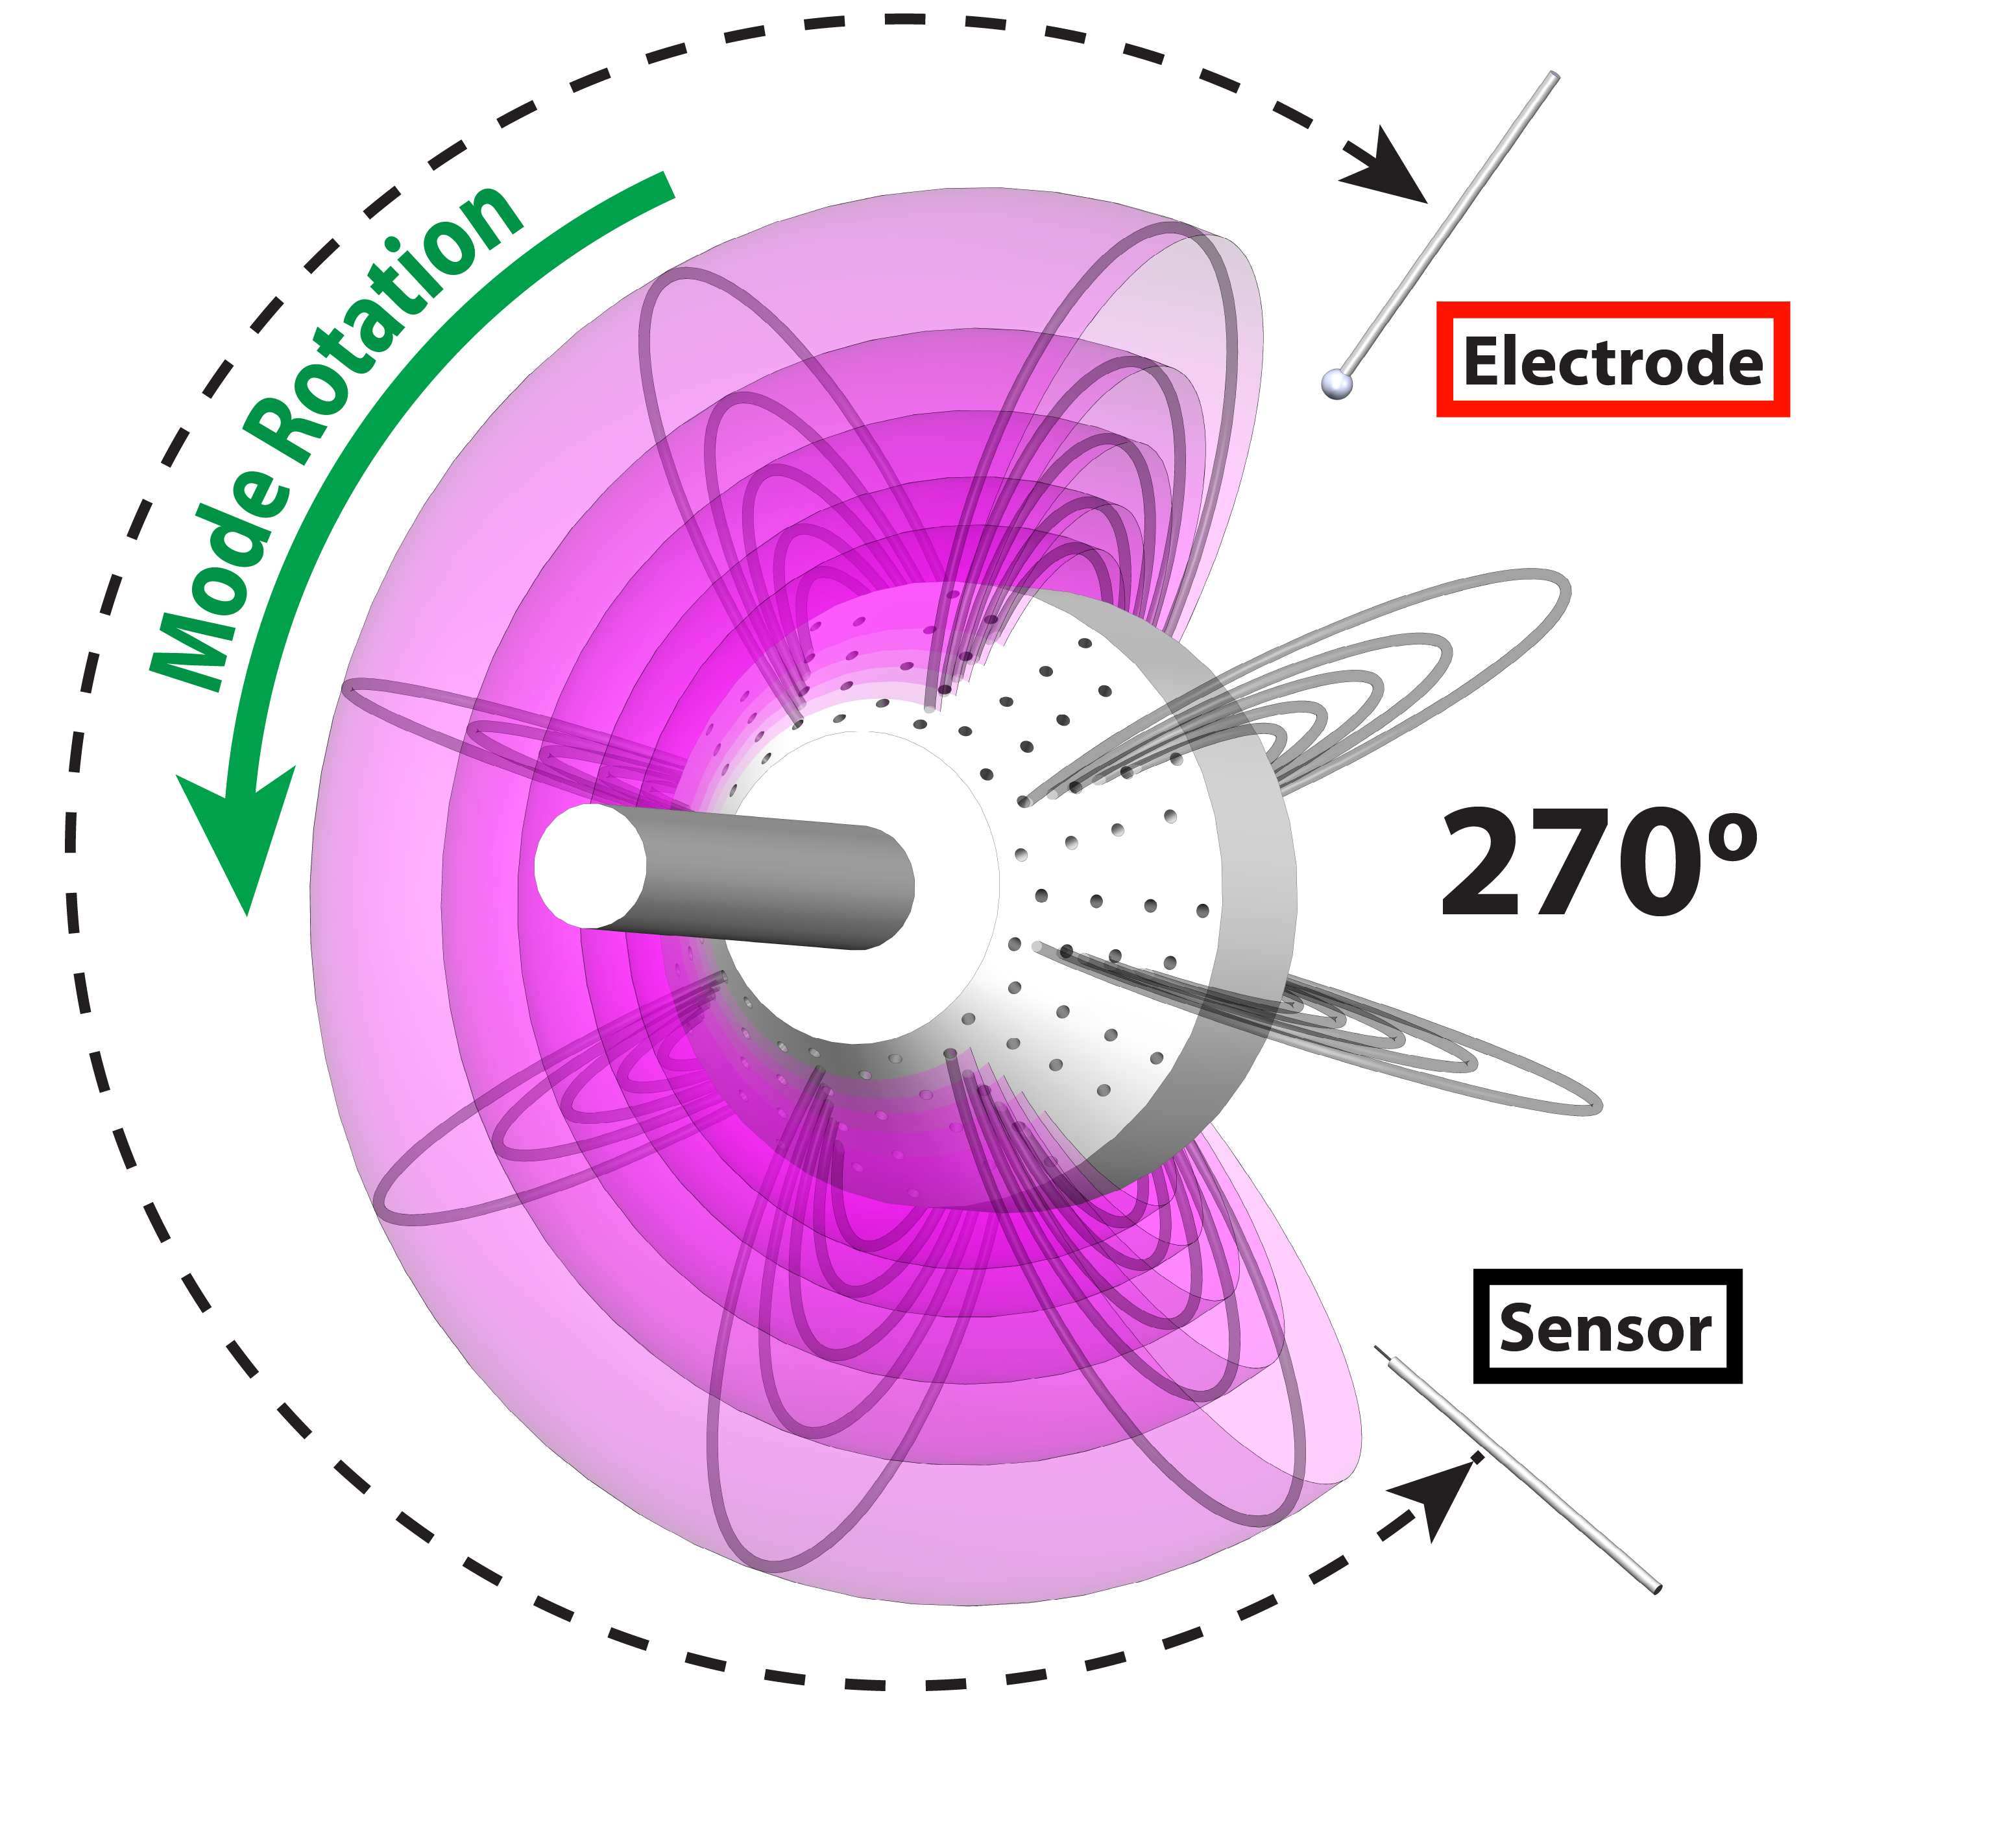
Varying the Separation between the Sensor and Electrode
No response with effective 270˚ separation

Slide 39
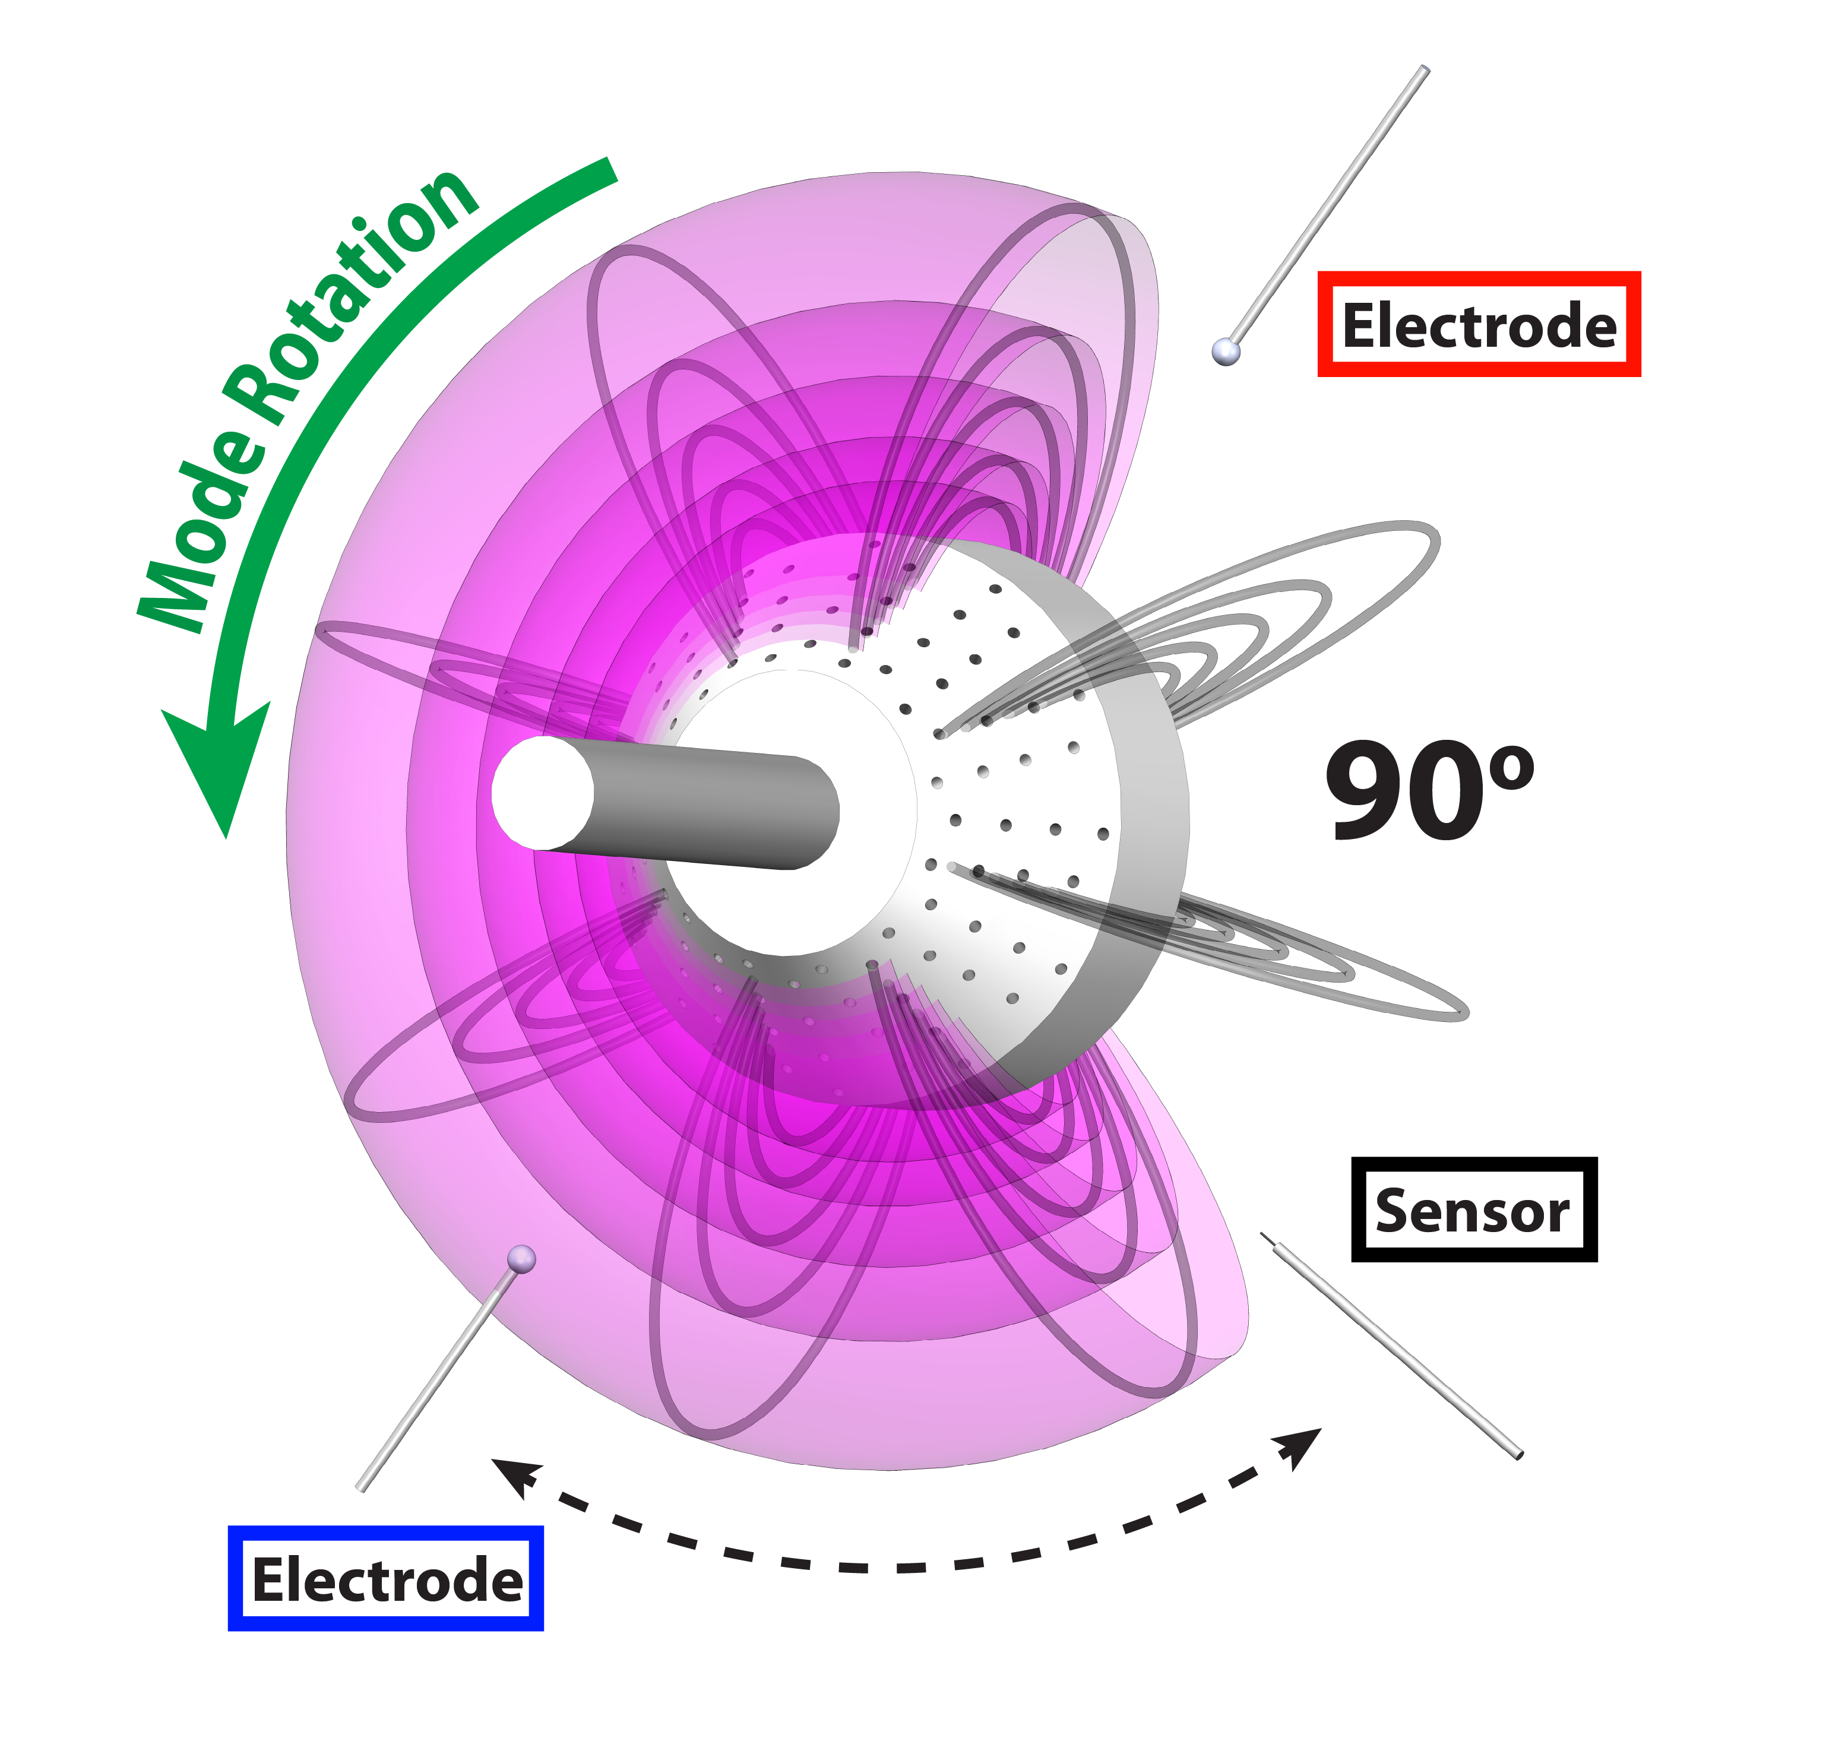
Varying the Separation between the Sensor and Electrode
“Upstream” electrode produces similar response

Slide 40

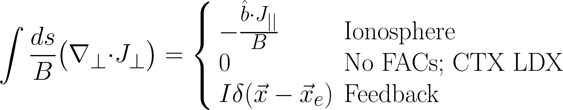
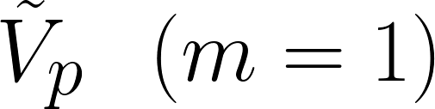
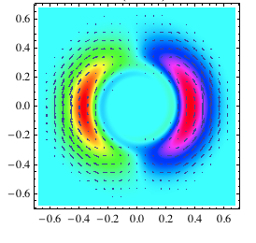
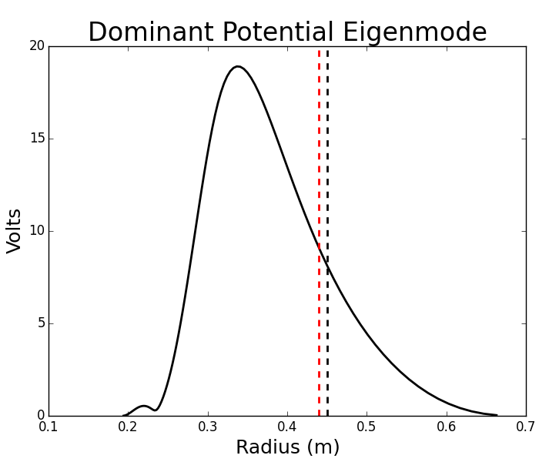
Flux-Tube Averaged Gyro-Fluid Model
Electron diamagnetic and ion inertial currents
Flux-Tube Average
Linearized and flux-tube averaged gyro-fluid model (Drake and Antonsen, 1984)
(Ricci, 2006)
Linear eigenmode, radially broad, low order azimuthal structure
Profiles consistent with measurements yield mode rotation of 4.5 kHz
Sensor and electrode locations

Slide 41
Flux-Tube Averaged Linear Model Shows Some Agreement
Fixed gain of 4
360 Phase Scan
Band Integrated (1-10 kHz)
Spectral Intensity
Amplitude
Intensity Weighted Frequency (1-10 kHz)
Frequency

Slide 42
Flux-Tube Averaged Linear Model Shows Some Agreement
Fixed gain of 4
360 Phase Scan
Band Integrated (1-10 kHz)
Spectral Intensity
Amplitude
Intensity Weighted Frequency (1-10 kHz)
Frequency

Slide 43
Ongoing Work
Current-collection feedback in a nonlinear gyro-fluid simulation.
Multiple independent feedback systems, and multipoint FPGA controlled feedback.
Turbulence control on LDX with levitated superconducting dipole.

Slide 44
Results and Conclusions
Broadband current-collection feedback amplifies or suppresses the interchange-turbulence.
Current-collection feedback is localized and in the direction of mode rotation.
Depending on phase, feedback is a generator or a load, either injecting or extracting power from the fluctuations.
A linear flux-tube averaged gyro-fluid model including a point current source shows some agreement with experiment.

Slide 45
Thanks
Thanks to the help of many contributors:
Michael Mauel, Jay Kesner, Darren Garnier, Matthew Worstell, Matthew Stiles Davis, Kristina Lynch, Abed Balbaky

